Slide 1


Slide 2
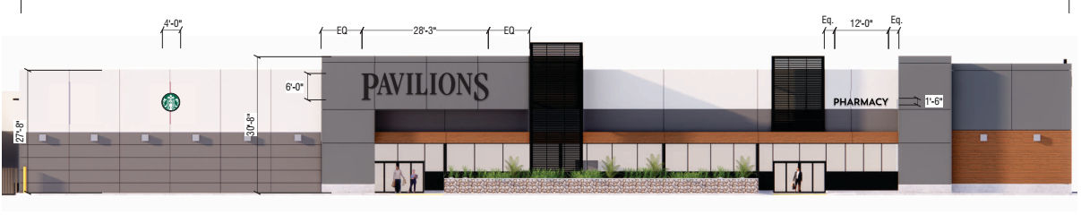
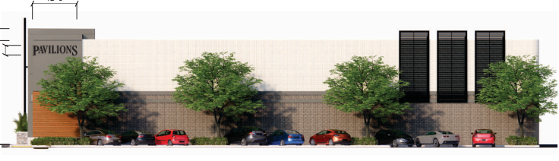
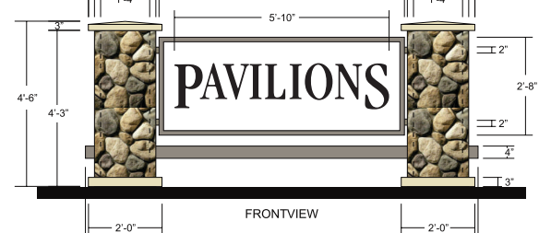
    PROJECT DESCRIPTION
    Three (3) new wall signs facing Fair Oaks Avenue
    One(1) new wall sign facing Monterrey Avenue
    Reface existing monument sign and repaint to match building.

Slide 3
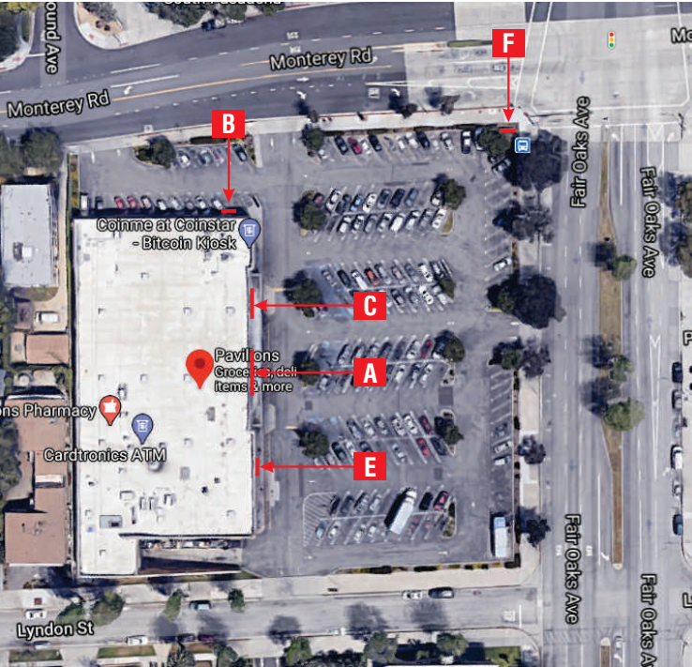
N

Slide 4
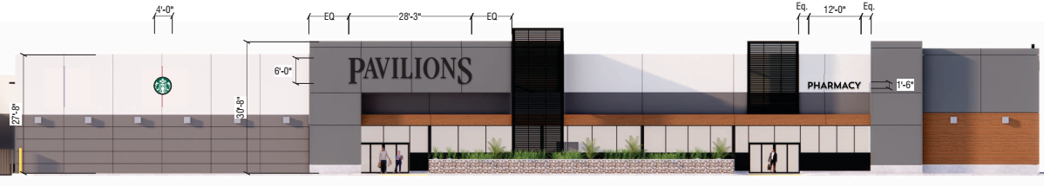
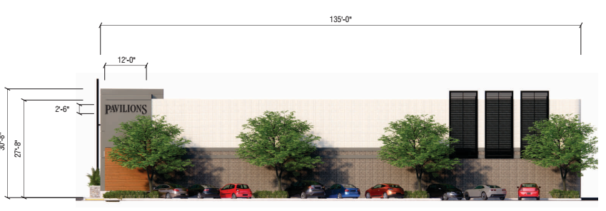
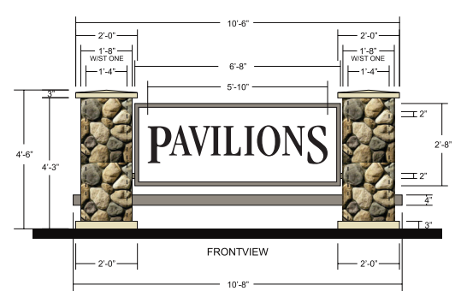
Sign Area Interpretation
200 sq. ft.
+17.7 sq. ft.?
+30 sq. ft.?
Sign Ordinance “use” Interpretation meeting
No more than 200 sf is allowed for each use?
Each use would be separate tenants, not individually licensed product/business within

Slide 5
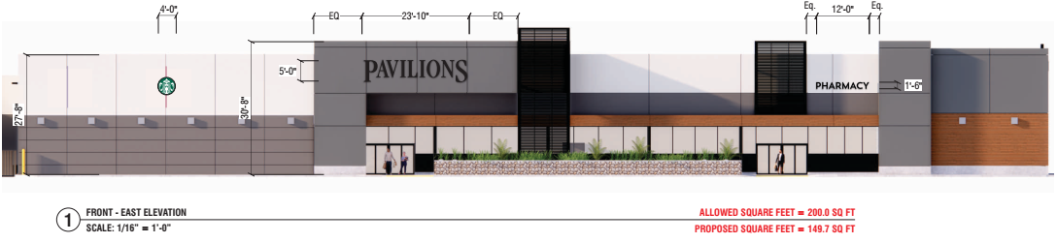
Reduced Sign Size
Proposed Sign Size

Slide 6
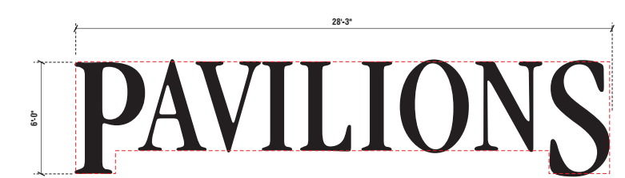
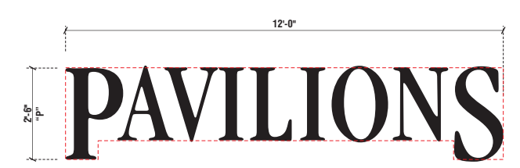
Sign Calculation
Previous=247.70 sq. ft. achieved by using four lines.
City permits calculating signage with no more than eight lines

Slide 7
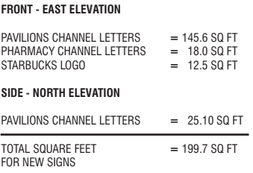
Sign Calculation
Previous=247.70 sq. ft. achieved by using four lines.
City permits calculating signage with no more than eight lines

Slide 8
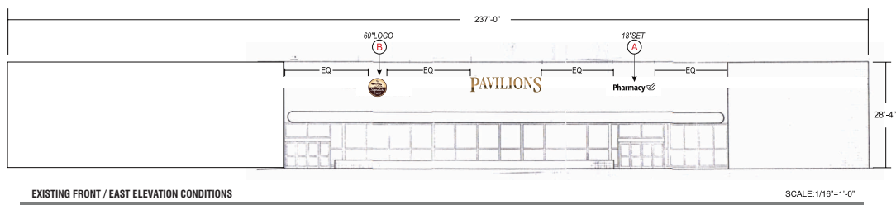
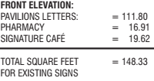
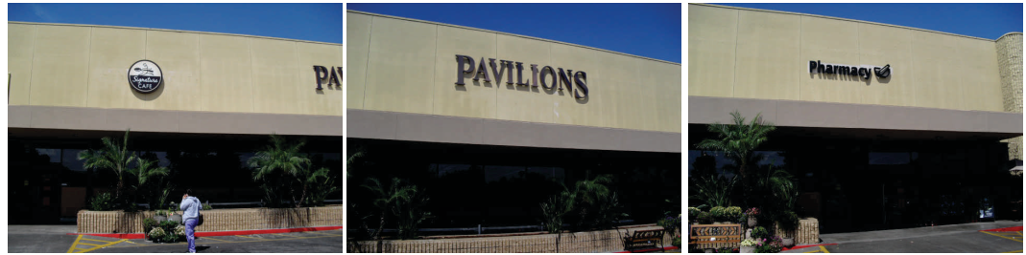
Existing Sign

Slide 9
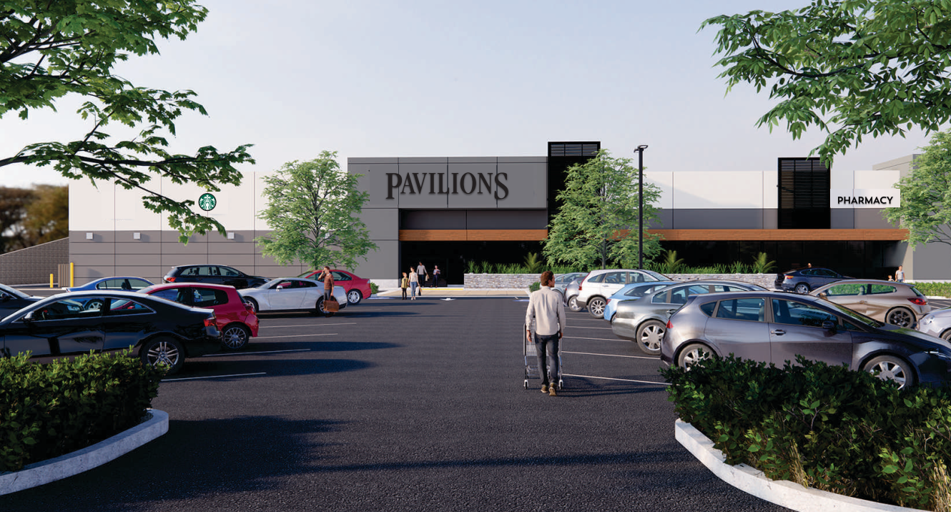
Front Elevation Rendering

Slide 10
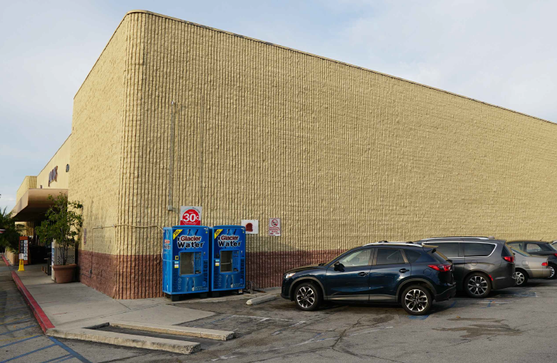
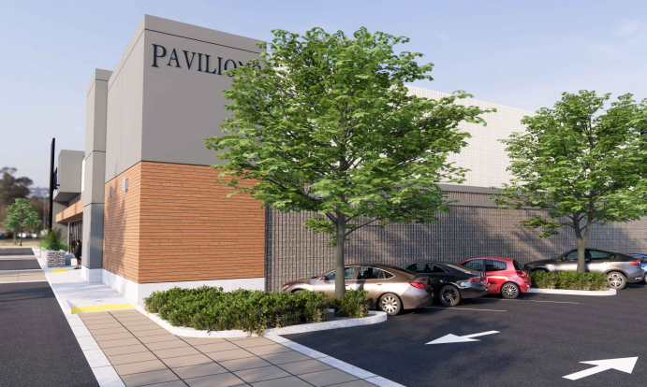
Existing vs. New North Elevation Sign

Slide 11
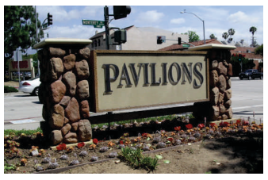
Signage: Existing and Proposed Refacing

Slide 12
STAFF RECOMMENDATION:
Approve the Sign Plan subject to conditions .

Slide 13
Design Review Board Options:
Approve with condition(s) added;
Continue the project to address comments discussed; or
Deny the project.

Slide 14
Questions?

