Slide 1
Notes:
Good evening commission members, tonight staff will be providing an overview of the project proposal for a design review and hillside development permit, as well as a tree removal permit at 804 Valley View Road. The Commission continued the project to allow the Applicant (DKY Architects) and Staff time to provide additional information to address comments from the Planning Commission from the last meeting as well as public comments received.

Slide 2
Project Description
Proposal: new 3,125 square foot single-family hillside residence on a vacant lot located at 804 Valley View Road.
CEQA: An Addendum was prepared to a Negative Declaration prepared in 2017, since the proposed project is closely similar to the approved project on the same property. The new project will not result in or create any significant or potentially significant environmental impacts.
Notes:
Project Description: The applicant is requesting approval to build a new three-bedroom single-family residence of 3,125 square feet including an attached 572 square foot two-car garage on the vacant upsloping hillside lot. The applicant is resubmitting a project application a new hillside home residence that was previously approved on the same property by the Planning Commission in Oct, 2017.
CEQA: An Addendum to a Negative Declaration was prepared, since the proposed project is closely similar to the approved project in 2017 The Negative Declaration document filed with Los Angeles County in 2017 for the original project, The project will not result in or create any significant environmental impacts. No mitigation is necessary as part of the Negative Declaration because the conditions of approval contained in the Hillside Development Permit will mitigate any potential impacts to the “less than significant” level.

Slide 3
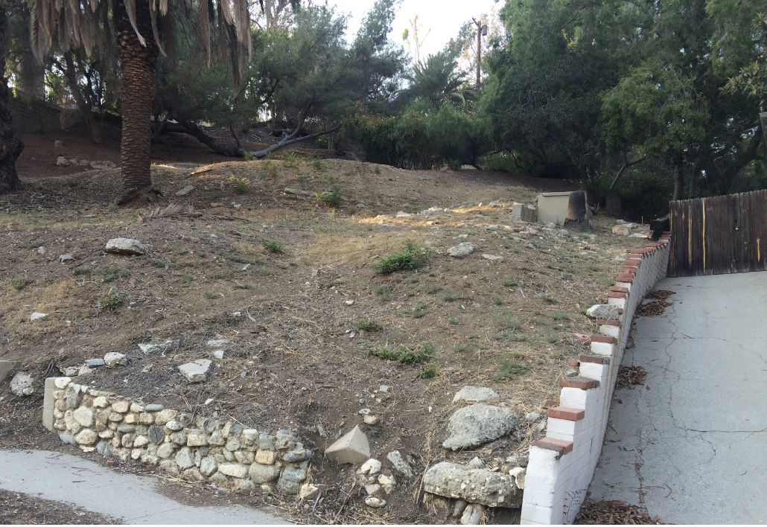
Notes:
Several public comments were submitted regarding trees on the site and their potential historic importance within the Valley View Heights neighborhood. An updated Historical Resources Evaluation analysis of the trees was prepared to determine if they contribute to the historical significance of the Valley View Heights District. An updated arborist report was also prepared to determine the age and conditions of the trees. The review of the onsite trees concludes that, while these trees are notable on account of their maturity, they do not appear to be associated with a deliberate landscape or planting plan that is associated with the origins or historical development of the neighborhood.
The trees and other onsite landscape features (with the exception of the stone wall along Valley View Drive, which has been noted as a resource to be protected) do not appear indicative of any special aspects of the neighborhood’s history. The trees are not historically significant and do not merit further historic preservation review under the California Environmental Quality Act (CEQA).

Slide 4
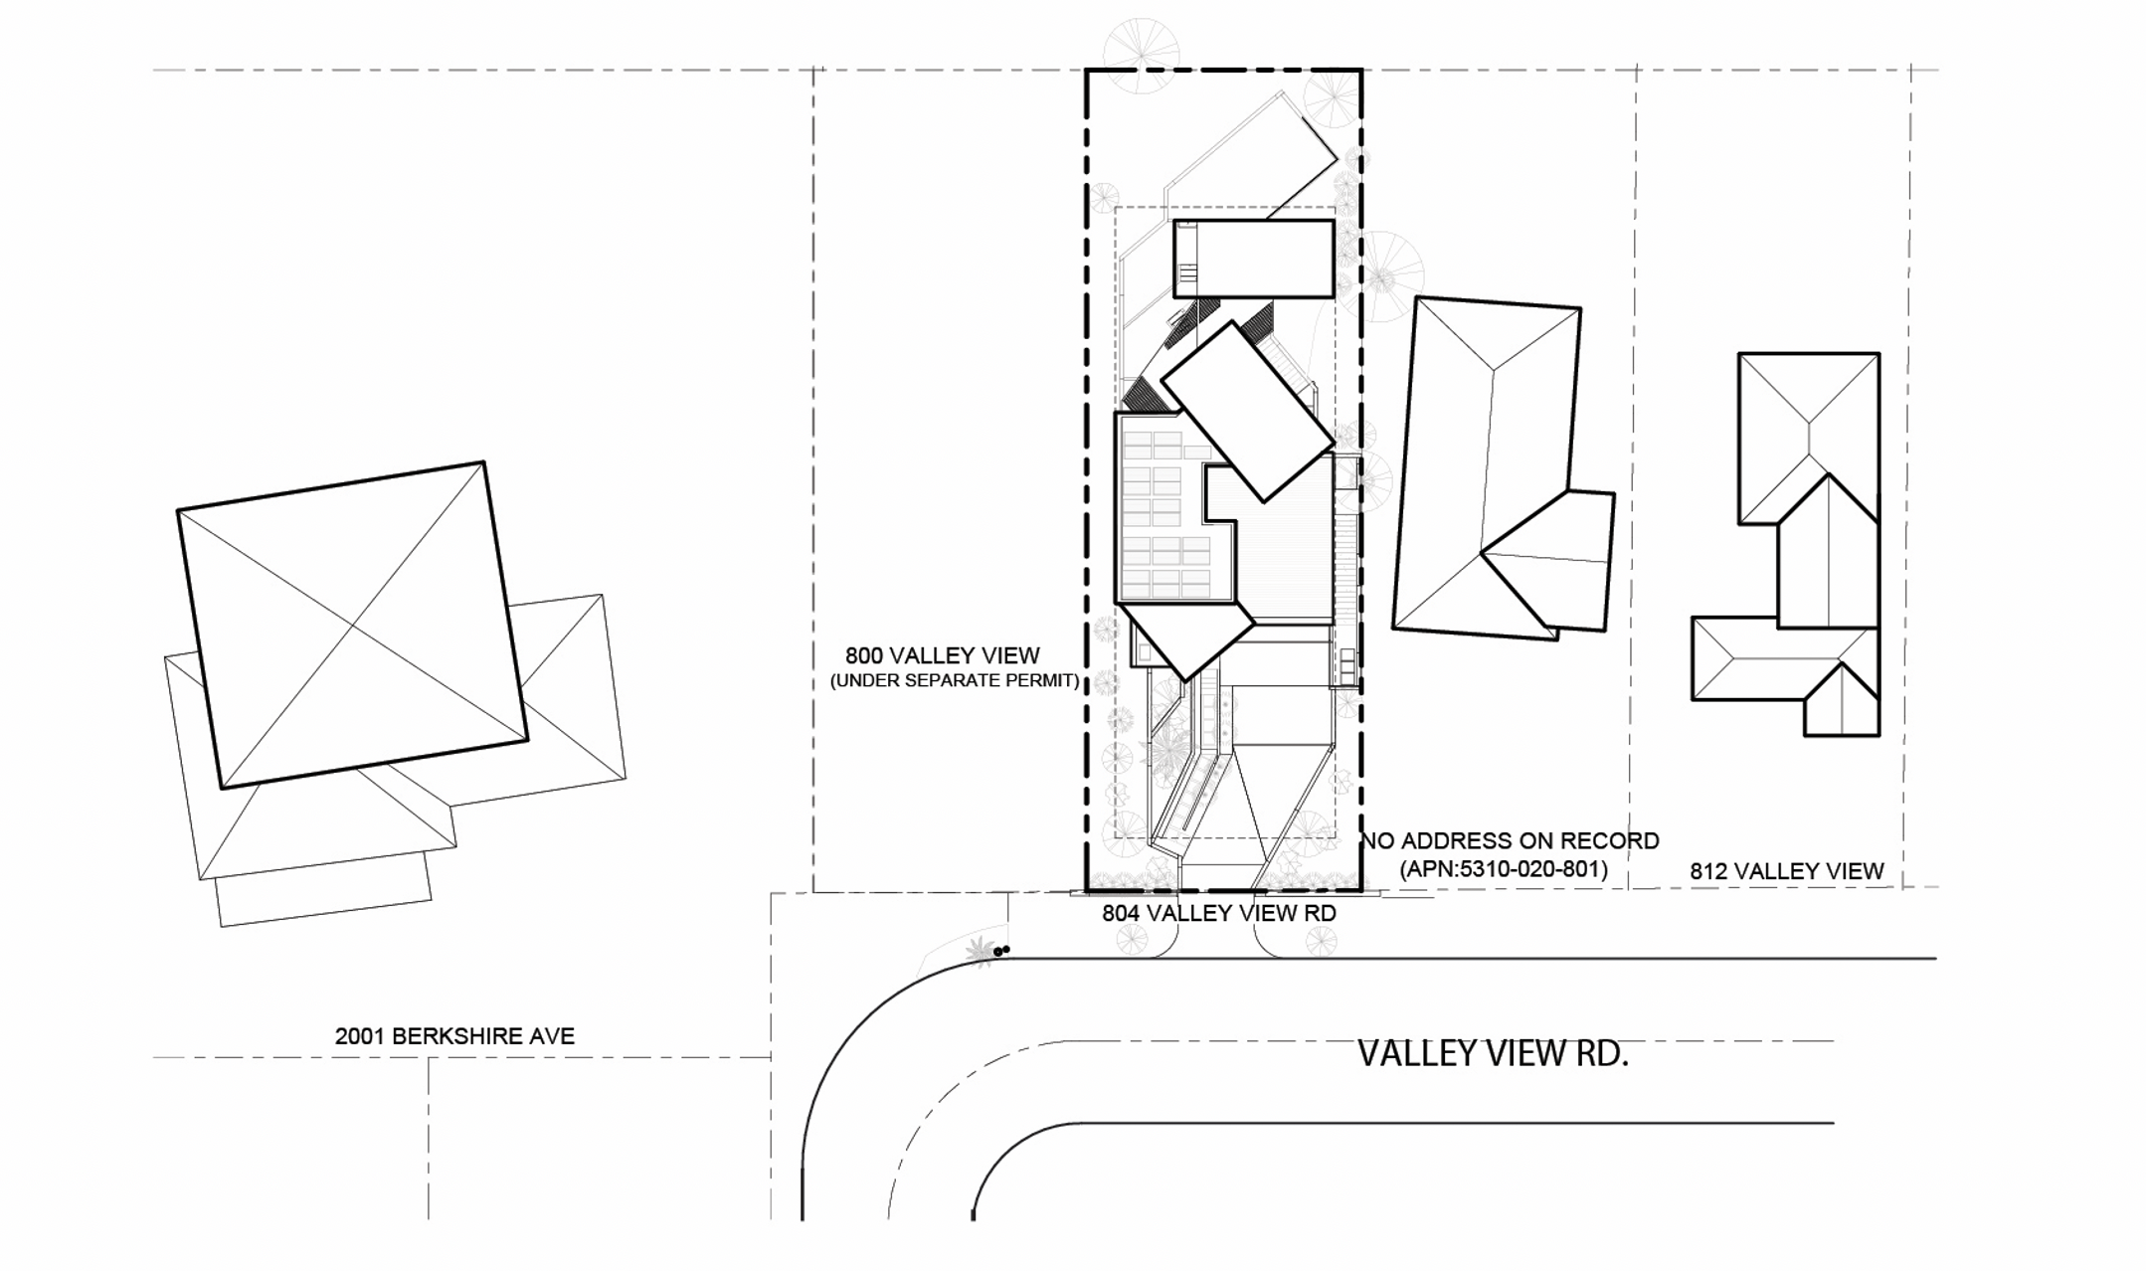
Proposed House in Relationship to Surrounding Homes
Notes:
This drawing shows the proposed single-family house in relationship to neighboring homes. The design of the home follows the City’s design guidelines for hillside properties by terracing the residence to reduce visual mass and mitigate retaining walls. Roof forms will include a combination of flat and low-pitched roof forms broken into a series of smaller building components/roof lines which ascend the hillside in an effort to reduce the scale of the project. The varying roof forms used in the design are found on homes throughout the neighborhood.

Slide 5
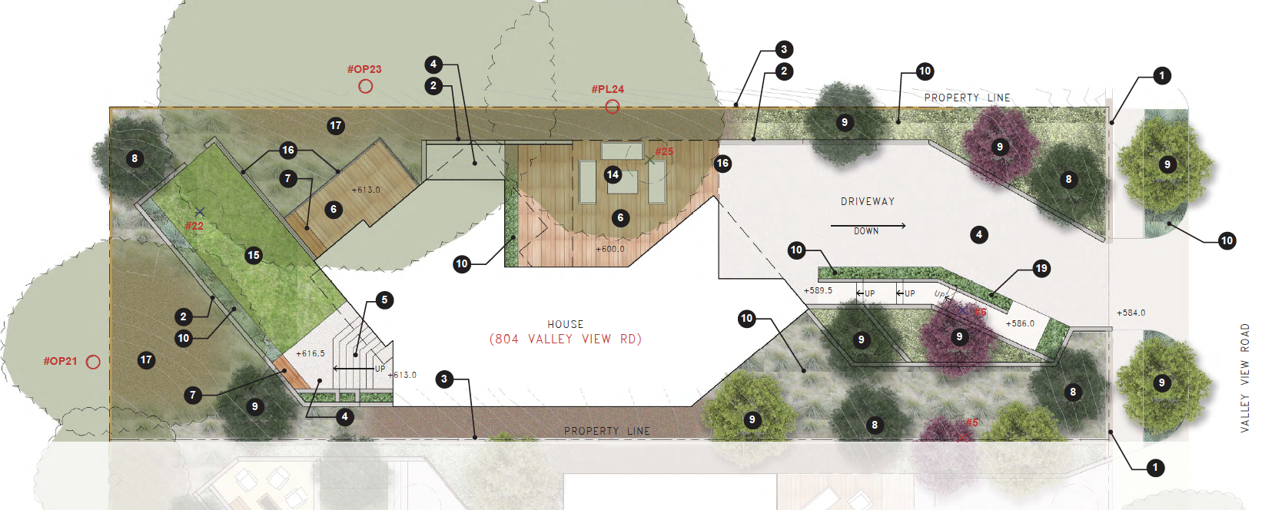
Notes:
To address local residents’ concerns of soil instability, soil control measures are required of the Applicant during the plan check process with the Public Works Department and the Building and Safety Division. The Applicant is proposing a landscaping plan that incorporates plantings and substantial tree replacements including a rainwater retention system (3,500 gallon rain harvest tank located at the lower end of the site), which would limit potential for soil erosion.
Additional public comments were received since the last Planning Commission meeting, which is summarized in the staff report and included in the revised conditions of approval in your packet.

Slide 6
Staff Recommendation:
Approve the Hillside Development Permit and Tree Removal Permit for:
3,125 square-foot house including an attached 572 square foot two-car garage
Removal of four trees and replacement with 11 trees
Addendum to the 2017 Negative Declaration

Slide 7
Planning Commission Options:
The Planning Commission can Approve with condition(s) added; or
The Planning Commission can Continue the project to address comments discussed; or
The Planning Commission can Deny the Project.

Slide 8
Questions?
Notes:
This concludes the presentation and staff is available to answer any questions if there are any. Thank you.

