Slide 1
Notes:
Good evening Chair and Commissioners. My name is Jennifer Williams and I am a contract planner for the City of South Pasadena.
The item before you is Project No. 2309, which includes a Hillside Development Permit, a Design Review case, a Parcel Merger, and a Tree Removal permit for the property located at 23 Short Way

Slide 2
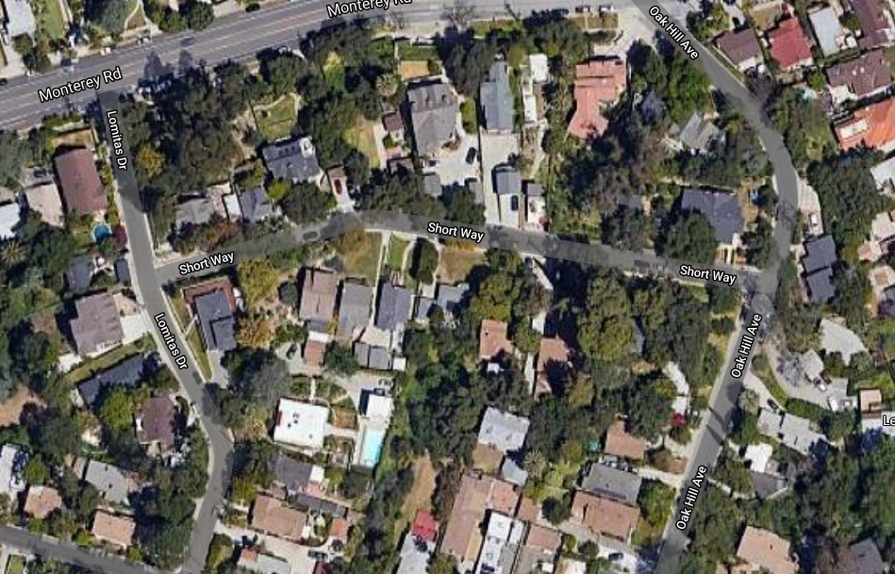
Aerial View
N
Notes:
The project site is located in Monterey Hills on the south side of Short Way, which is south of Monterey Road between Lomitas Drive and Oak Hill Avenue. The boundary line between the City of South Pasadena and the City of Los Angeles runs in a north/south orientation across the lot directly to the west.

Slide 3
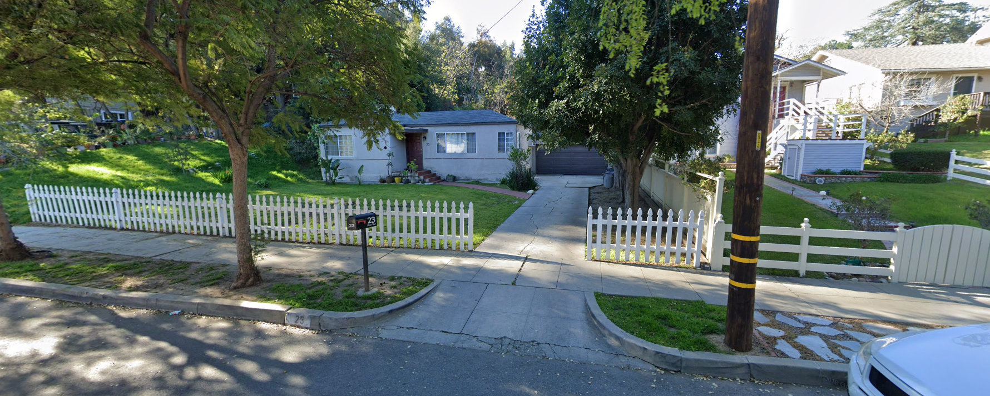
Street View
Looking south, from Short Way
Notes:
The subject site is currently developed with a single-family home with an attached garage. The current property owners purchased the property in 2019 and secured approval from the Cultural Heritage Commission in September of 2020 to demolish the existing structures onsite. They are seeking to develop a new home on the site.

Slide 4
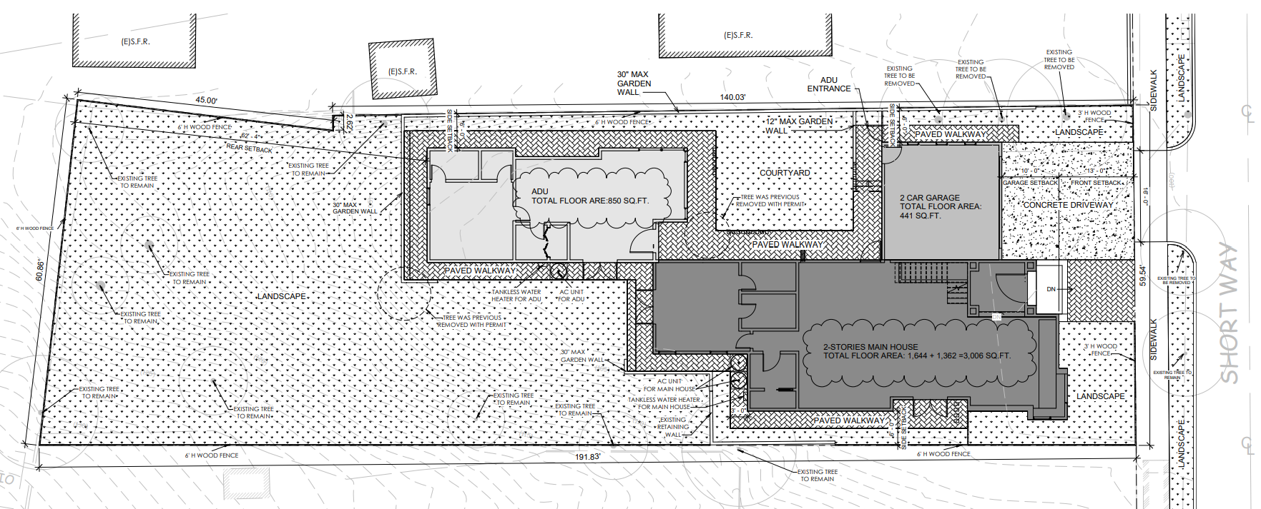
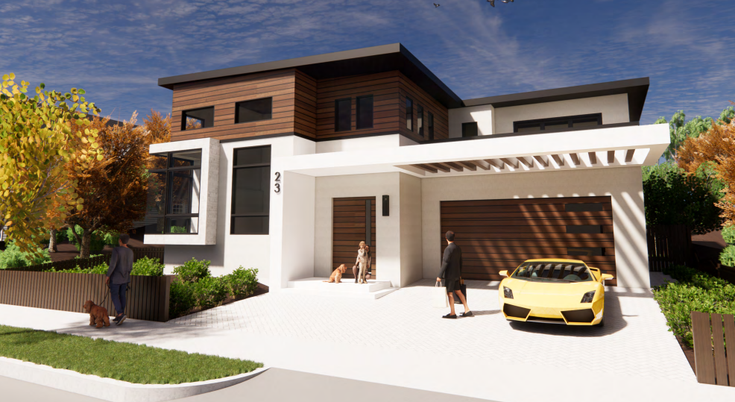
Project Description
Lot:
11,018 sf
25.64% slope
House:
3,006 sf
2 levels
Attached garage:
2-car
441 sf
Detail of Site Plan
Architectural Rendering
Notes:
The proposed project includes the development of a 3,006 square foot two-story home with an attached 441 square foot garage. An attached 850 square foot Accessory Dwelling Unit is also proposed and shown on the plans; however, the formal approval would be issued administratively after the discretionary entitlements are secured.
The subject site consists of two separate parcels that would be merged as a condition of approval to create a combined 11,018 square foot lot.
The average slope of the lot is 25%, which results in the requirement for the hillside development permit to ensure that the development of the lot is consistent with the city’s development standards and design guidelines for hillside homes. The design review case is required for the construction of a new home.
A tree removal permit is also required for the removal of three (3) trees in order to accommodate the proposed development. Originally the applicant had proposed removing four (4) trees; however, after consultation with the Public Works Department, that request was modified. An Arborist report was prepared for the project, and the City Arborist conducted a site inspection on March 25, 2021. The tree removal request was presented to the Natural Resources and Environmental Commission (NREC) on April 27, 2021. The NREC recommended approval to the Planning Commission.

Slide 5
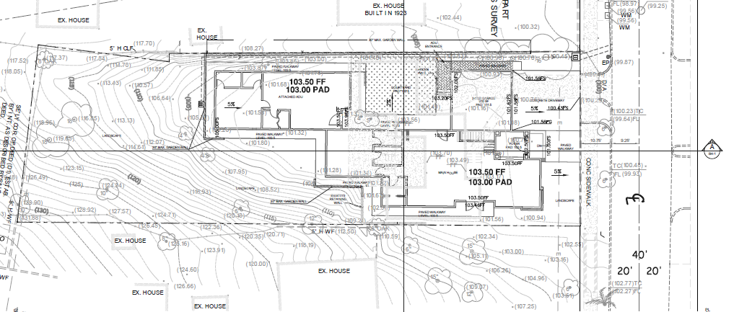
Design Review – Site Planning
Notes:
The proposed development consists of one connected structure that functions as 3 separate spaces; the two-story residence, the attached single-story garage, and the attached single-story accessory dwelling unit. The improvements are sited on the flattest portions of the lot to minimize the amount of impact to the sloped hillside areas of the lot and reduce the amount of grading required
Please note in the top image, which is taken from the conceptual grading plan, that the contour lines indicate the steepest sloped portions of the lot are in the rear of the site, while the proposed structures are located on the flattest portions, just as the existing single-family home and garage that will be demolished are sited.
The bottom image, Section A, also demonstrates the quick change in slope beyond the footprint of the house.
A total of 50 cubic yards of cut and 125 cubic yards of fill are proposed for a total of 75 cubic yards of import. The tallest walls proposed on site are a maximum of 30”. The applicant has worked with staff through multiple revisions to minimize the impact to the hillside area.

Slide 6
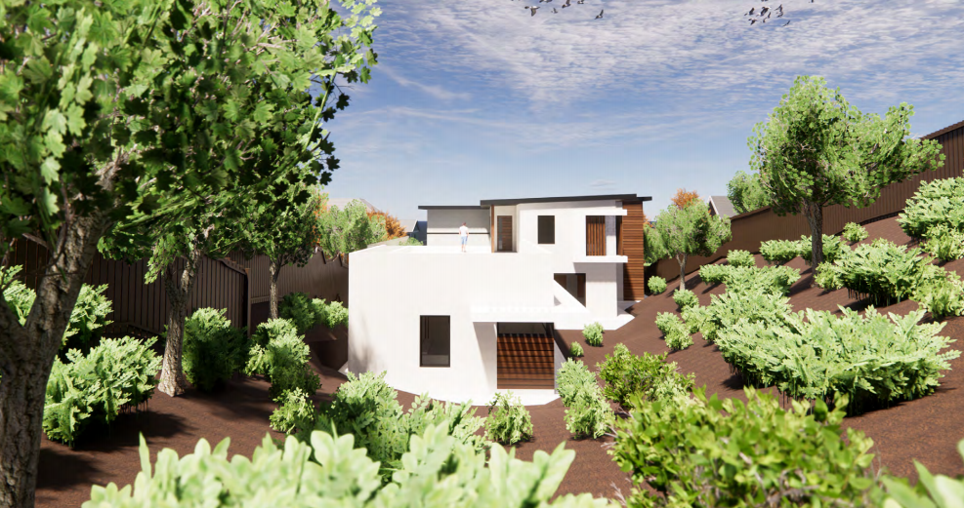
Design Review – Site Planning
Notes:
This rendering provides a view of the south elevation of the accessory dwelling unit and house, looking north from the rear of the site. You can see the quick slope up past the footprint of the house.

Slide 7
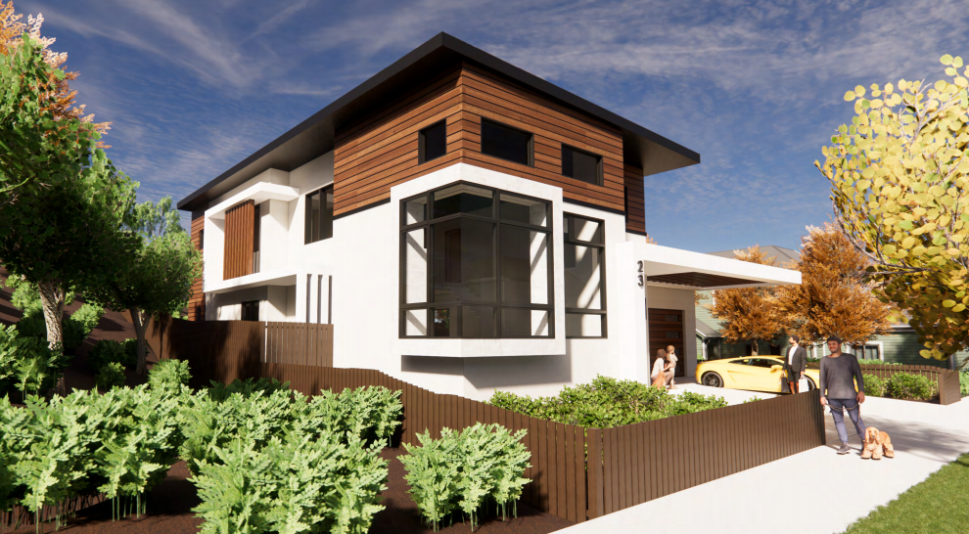
Design Review – Architectural
North (Front) Elevation-
From Street
Looking south/southeast
North (Front) Elevation-
From Street
Looking south/southwest
Notes:
The proposed development boasts a modern architectural design and features a flat roof, rooftop patios, and the use of smooth stucco, Innoclad wood composite horizontal siding, and the incorporation of marble and glass with large windows and doors. The height of the building is approximately 24 feet.
Both of the homes on the lots immediately adjacent are also 2 stories in height.
The front elevation is shown from 2 vantage points from the street in these renderings, the top image looking southeast and the bottom image looking southwest.

Slide 8
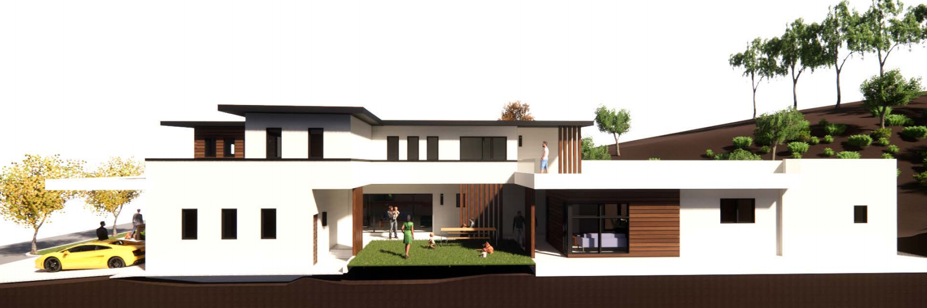
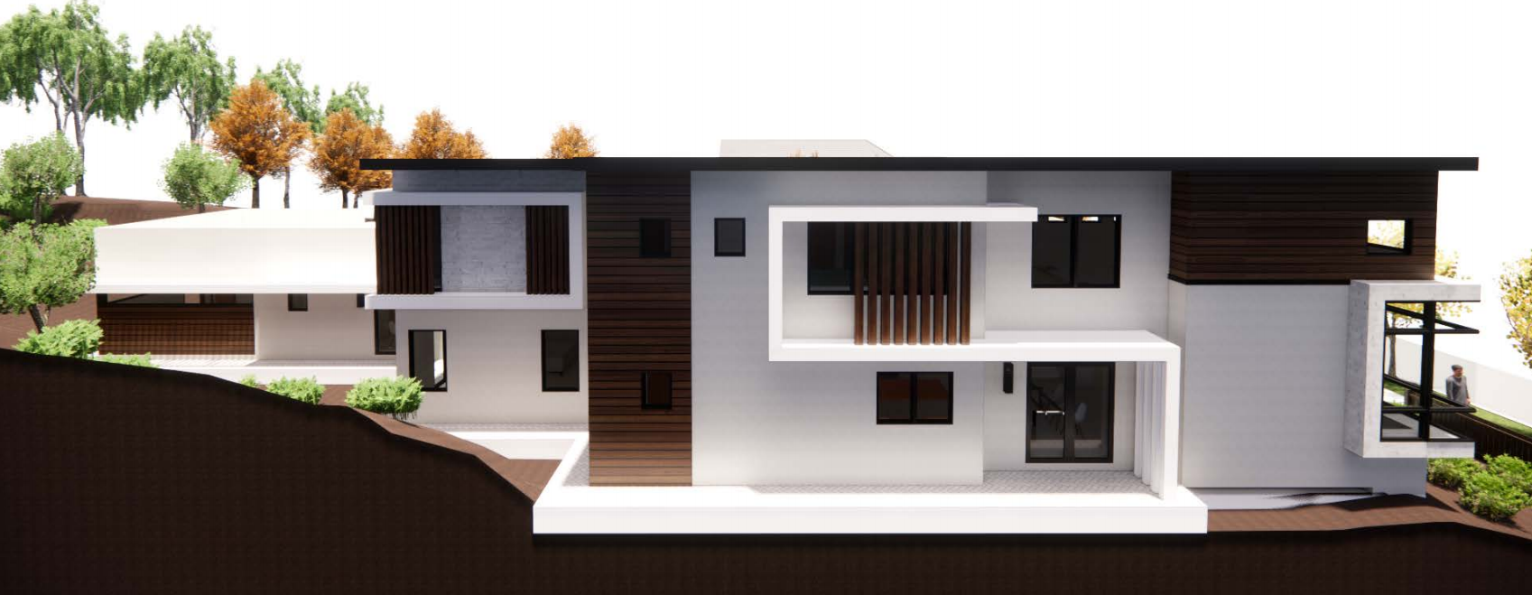
Design Review – Architectural
West (Side) Elevation
East (Side) Elevation
Notes:
The west elevation is shown in the top image.
The east elevation is shown in the bottom rendering.

Slide 9
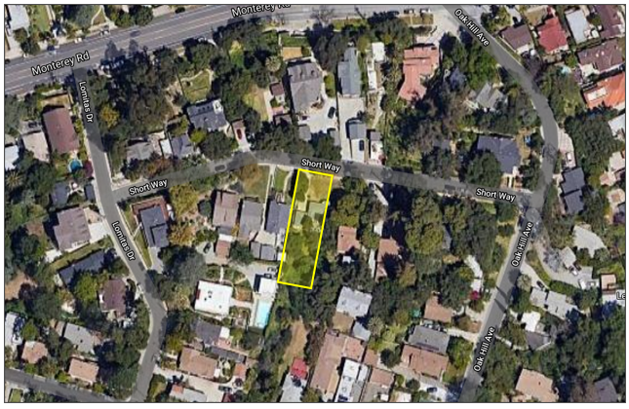
Technical Reports
CEQA Review
Categorical Exemption
Section 15332-
Class 32, In-Fill Development
Preliminary Geotechnical
Biological Survey
Findings
Hillside Development Permit
Design Review
Notes:
Technical Reports
A Preliminary Geotechnical Report was prepared which concluded that the site is suitable for the proposed development from a geotechnical aspect provided that the report recommendations are incorporated into the project design and implemented during construction.
A Biological Survey was also prepared which concluded that no direct or indirect effects to sensitive plants or animals are expected to occur from the project construction with implementation of avoidance measures. These measures include the requirement for a nesting survey if project construction is initiated during nesting season, and that a no-work buffer be established or biological monitoring be provided should nests be found.
Entitlement Findings
In order to approve the Hillside Development Permit and Design Review case, the Planning Commission must adopt specific findings with supporting evidence for each entitlement.
In reviewing the application staff determined that the Project meets all required findings
The findings and supporting evidence are provided in the resolution which is included as Attachment 1 of the staff report.
Findings are not required to approve the Tree Removal Permit or Parcel Merger.
Environmental Analysis
In accordance with the California Environmental Quality Act (CEQA), the project qualifies for a Categorical Exemption under Section 15332, Class 32 In-Fill Development projects
The findings and evidence supporting the CEQA determination are also included in the resolution

Slide 10
Staff Recommendation
Approve the Hillside Development Permit, Design Review, Parcel Merger, and Tree Removal Permit
Planning Commission Options - Alternatives to Staff Recommendation:
Approve with modified/additional conditions
Continue the public hearing
Deny the project
Notes:
Staff is recommending that the Planning Commission approve the Hillside Development Permit, Design Review case, Parcel Merger, and Tree Removal Permit.
Alternatively, the Planning Commission may approve the project with additional or modified conditions, continue the public hearing and request additional information, or deny the project.

Slide 11
Questions?
Notes:
This concludes staff presentation and staff stands ready to answer any questions you may have.

