Slide 1

The Anti-Bias Club’s BLM Mural Proposal
Wednesday, August 19

Slide 2
Anti-Bias Club background:
The Anti-Bias Club was formed by a group of SPHS students who participated in a two day training with the Anti-Defamation League in October 2019.
The Anti-Bias Club’s mission is to promote inclusivity and mental wellbeing on campus and in the broader community.
Some of our other projects:
  Mental health, making SPHS more LGBTQ+ inclusive, creating a book on South Pasadena’s history of racism & connecting it to today

Slide 3
Inspiration/purpose for the mural
The mural was inspired by the recent momentum for the Black Lives Matter movement and a wish to create an image that would be in our community representing what we value.
The mural’s purpose is to create a longstanding image in South Pasadena that shows powerful Black lives, historical references, and to serve as a reminder that our work fighting racism isn’t done.
Serves as a celebration of Black people and social justice and also as a tool to educate people

Slide 4
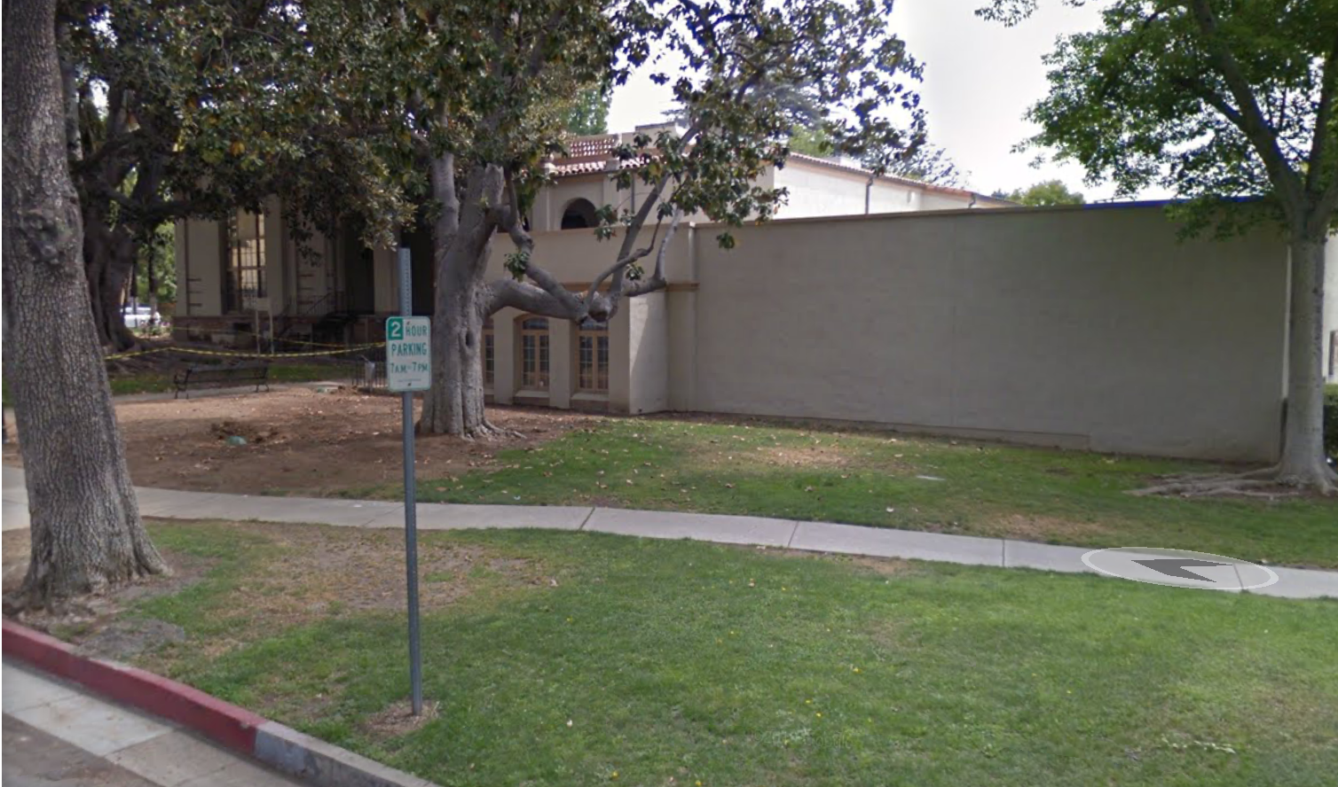
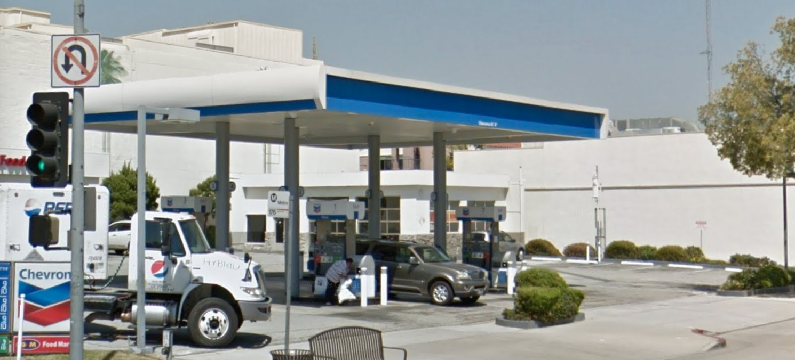
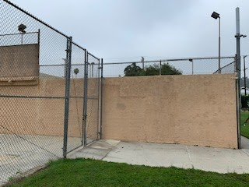
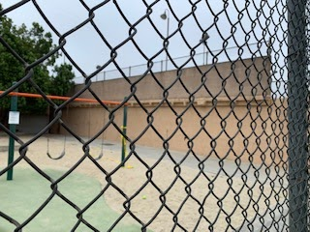
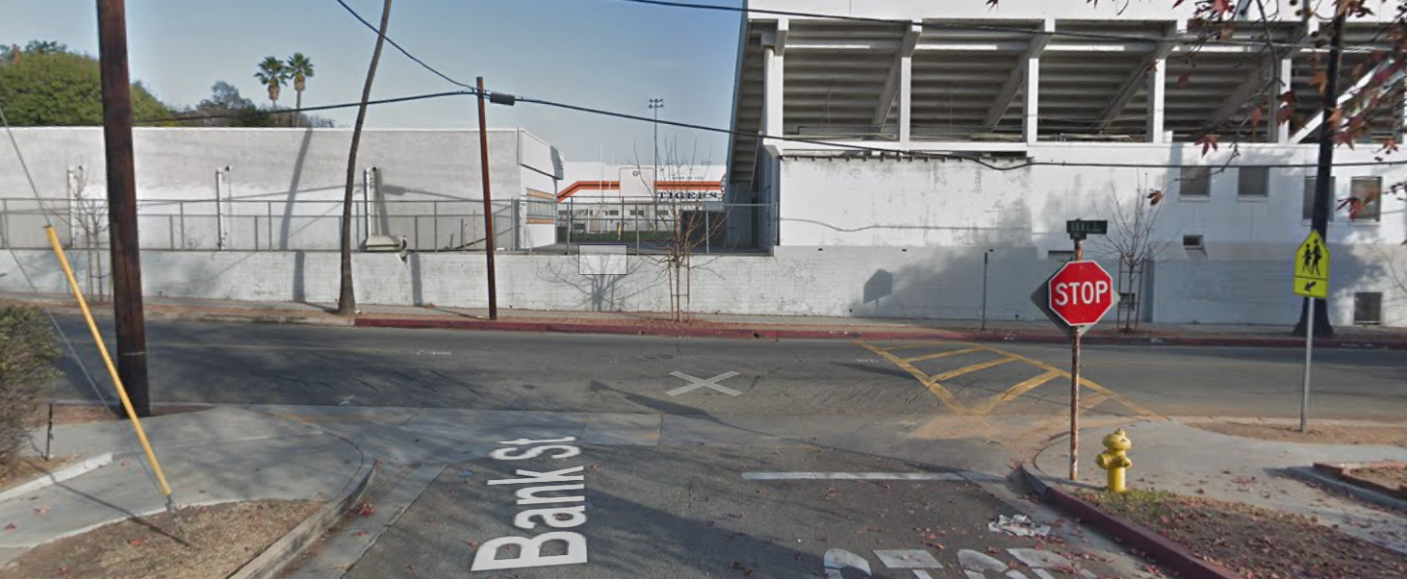
Proposed mural locations
West side of the library facing Diamond Ave
West side of City Hall facing the gas station
Orange Grove recreation tennis courts on El Centro St.
Backside of high school track facing Meridian Ave.

Slide 5
Specific themes to include in the mural
What will be represented?
  Continuation of…
    Abolition movement
    Civil rights movement
    Black power movement
    BLM movement
  Will be shown though famous black figures from past to present
  Will also represent famous Black artists who embraced their culture (Harlem Renaissance)
What is the Goal?
  To display the strength and endurance of the black community.
  Hence Breonna Taylor, George Floyd or any other victims of police brutality will not be shown
  Want to connect this to both the present and history of South Pasadena
    Sundown town
What should be emphasized?
  Black strength
  Black power
  Black pride
Who will be represented?
  Diversity and intersectionality
  Black women
  Black LGBTQ+ community

Slide 6
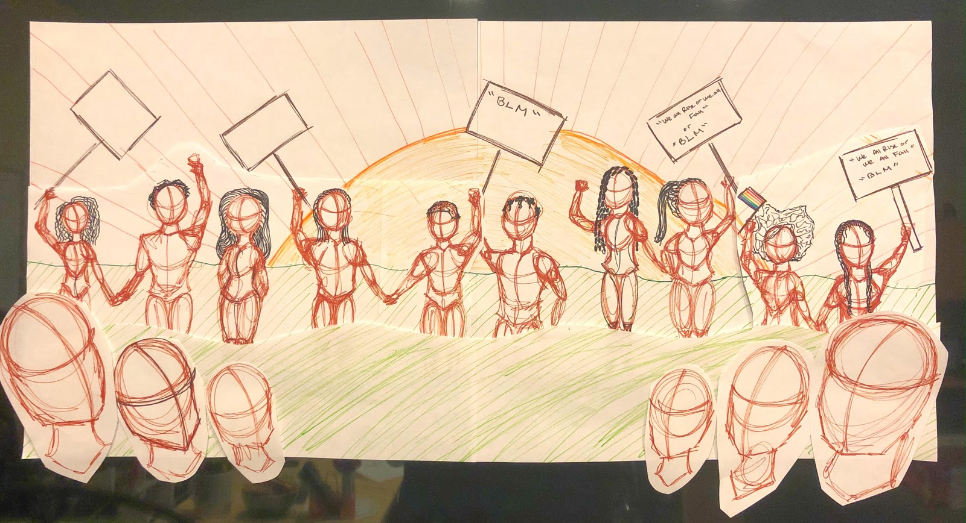
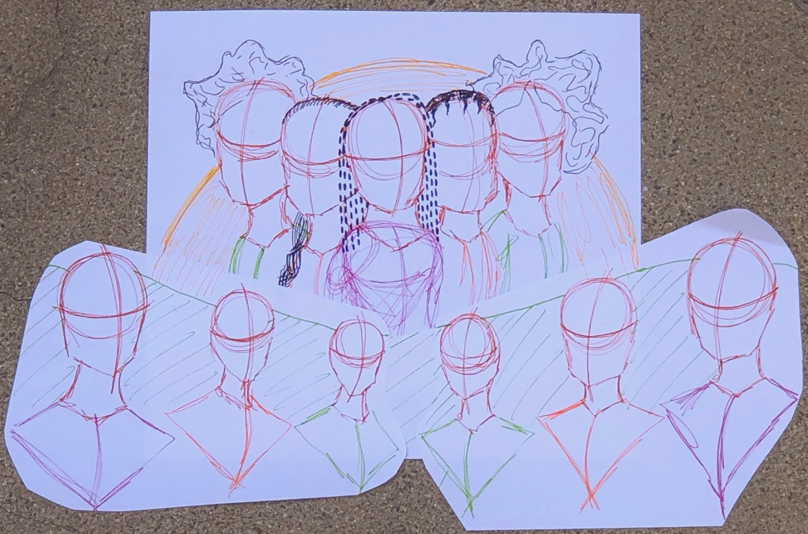
Maya’s sketches

Slide 7
Budget
The all-inclusive artwork budget is $10,000.
Budget includes:
  artist fees, liability insurance, artist travel, and all costs associated with the design, engineering, fabrication, permitting, delivery, and installation of the artwork.
Funds will be community-raised, with the SPHS Anti-Bias Club in charge of donations.
Excess funds raised will be donated to a non-profit that supports Black lives.

Slide 8

People involved
Members of the Anti-Bias Club:
  Noah Kuhn
  Lulu Talesnick
  Cat Flores
  Khalil Murdock
  Maya Turun
Club Advisor:
  Janet Anderson (Principal of South Pasadena High School)
Public Art Commissioners Phung and Dr. Sawyer have been assisting us with this process
We have also been incorporating community ideas through a google doc and several Zoom meetings

Slide 9
RFP process and where we are at
We have finalized the the RFP with our design and timeline, and are only awaiting an approved location
We will go back to the Public Art Commission on Aug. 26 to get approval for the RFP and then return to city council on Sept. 2 to get final location approval
We will email out the RFP to as many artists as we can with the help and connections of the City, schools, and Public Art Commission
Once we receive a sufficient number of applications we will pick the artist who best fits this project and our vision and begin working with them
Tentative Timeline
RFP sent out by Sunday, September 6
RFPs due back by Sunday, October 18
Decide on an artist by Sunday, October 1
Notify and meet with artist and agree on a contract by Sunday, November 15
Artist submits at least three design renderings by Sunday, December 20 and the selection committee will review and make recommendations on changes
Final approval of design rendering by Sunday, January 17. The Anti-Bias Club will present the design rendering to the Public Art Committee of South Pasadena for consensus.
50% mural completion by Sunday, March 14
Final mural completion and unveiling day on Sunday, May 2

Slide 10
Important to note:
The SPHS Anti-Bias Club will be in charge of maintaining the BLM mural
Additional community funds will be raised if needed to preserve it
The artist will also be required to sign a contract guaranteeing the quality and longevity of the mural

