Slide 1


Slide 2
    Subject Site

Slide 3
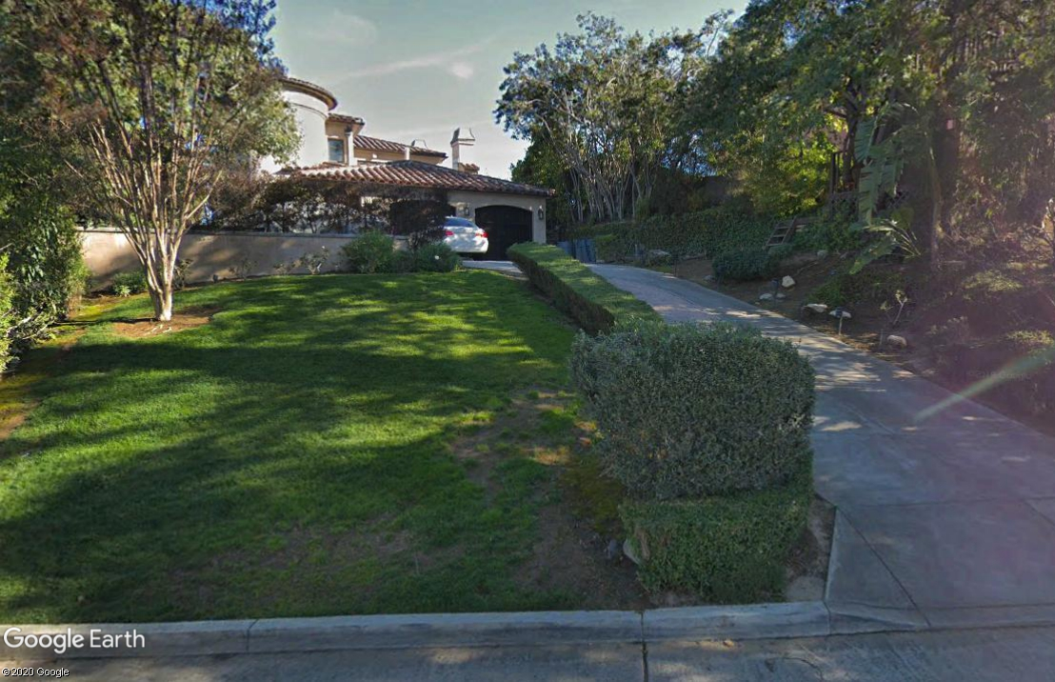
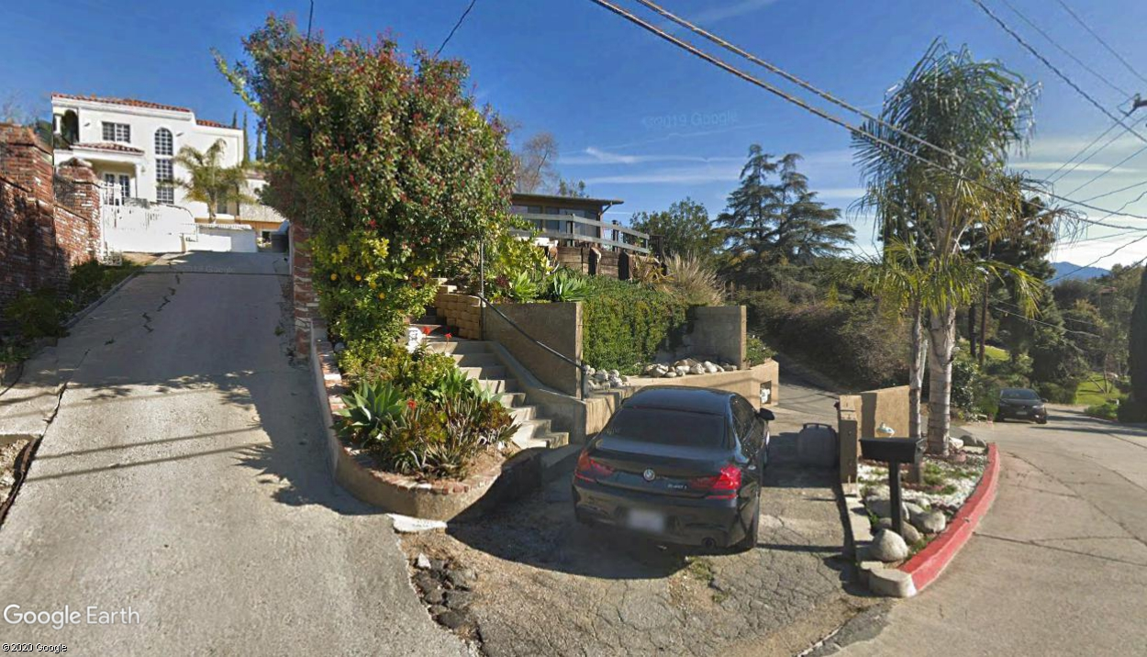

Slide 4
    Delisting Evaluation Process
Application Initiated
  Initiated by Property Owner
  Historic Resource Evaluation prepared by Sapphos Environmental. Report concluded that property lacks significance for national, state, or local designation
Cultural Heritage Commission Review and Recommendation
  Cultural Heritage Commission reviewed and recommended delisting at its November 19, 2020 Meeting
City Council takes Final Action

Slide 5
    Recommendation
    Approve the delisting request based on the finding that the structures lack significance for national, state or local designation
Questions?

