Slide 1
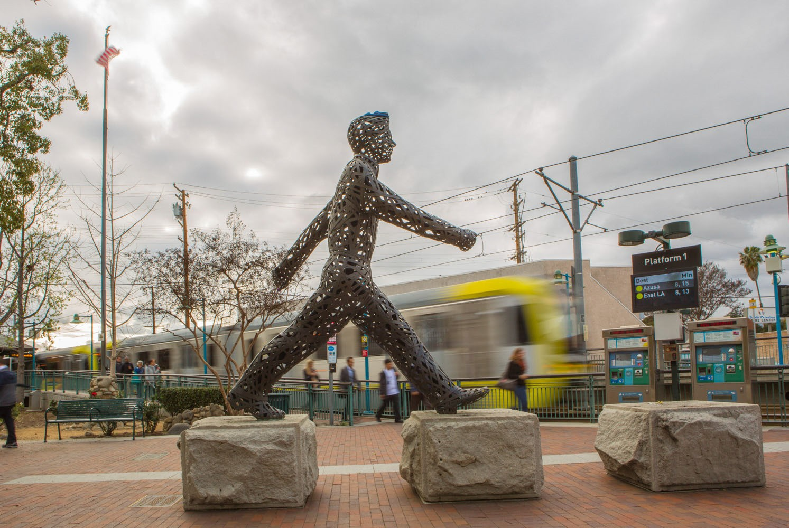
City of South Pasadena STRATEGIC PLAN 2021‐2026
Second Quarter Update Approved October 19, 2022

Slide 2
VISION STATEMENT
2021‐2026 STRATEGIC PLAN – SECOND QUARTER UPDATE
We are a culturally and economically diverse, and fiercely independent community that cherishes creativity, education and our small town character, committed to building a more just and environmentally and financially sustainable future.

Slide 3
2021‐2026 STRATEGIC PLAN – SECOND QUARTER UPDATE
1. Develop and Implement Strong Fiscal Policies to Ensure a Resilient Financial Future
Task | Action Item | Target Date | Department | Status
1a. Long Range Financial Plan | Complete Indirect Cost Allocation Plan to increase potential reimbursement for staff time on grants and special fund projects. | FY 22‐23 | Finance | Considering potential costing plan in early 23‐24.
1b. Reduce CalPERS unfunded liability | Explore and recommend options to reduce CalPERS and Other Post‐Employement Benefits (OPE) liability. | FY 21‐22 | Finance | Completed. City Council has moved to use the Cell Tower revenue ($4.3m) as well as $1m in General Fund reserves to pay down the CalPERS liability by $4.29m and setting up an OPEB trust through CalPERS (called CERBT) in the amount of $1.125m.
1c. Financial policies | Develop comprehensive Finance Department Policies and Procedures manual. | FY 21‐22 | Finance | In progress. First reading of the Finance Purchasing Ordinance presented to Council October 5, 2022, and Second Reading to follow. Upon approval, the Policies and Procedures will be complete.
1d. Business License Tax | Research and recommend update to business license tax, business classifications and tax rates. | FY 22‐23 | Finance | In progress. Anticipated timelines early FY 23‐24.
1e. Library Parcel Tax | Library Parcel Tax Renewal | FY 22‐23 | Finance/Library | Ballot to be voted on at the November 8, 2022 General Municipal Election.

Slide 4
2021‐2026 STRATEGIC PLAN – SECOND QUARTER UPDATE
2. Create a Strong Economic Development Strategy to Strengthen Local Business
Task | Action Item | Target Date | Department | Status
2a. Technology Upgrade | Recommend permit software & funding for building and planning to track permits online and streamline approval processes. | FY 21‐22 FY 22‐23 | Community Development (CD) | $160,000 grant received from the State. RFP was released in Spring 2022. Four (4) firms were interviewed in September. CD will bring a contract to City Council for consideration
2b. Economic Development Program | Develop and Launch Economic Program City Branding and Marketing Plan New City website New Economic Development (ED) website Ombudsman services develop a Guide on ‘How to Do Business in the City’ Launch of Citywide App | FY 22‐23 | City Manager’s Office | Business Concierge Program has launched, including Business Visitation and Business Review Programs, as well as ombudsman service. The new City website and Economic Development sub‐site budgeted for in FY 22‐23 Proposed budget; improvements being made to current site. Completed Branding Guidelines. Completed Guide to Doing Business.
2c. Economic Development Plan | Produce a permit application guide to help streamline application process. Included as part of the Guide to Doing Business | FY 22‐23 | City Manager’s Office/ Community Development | To date Applicant Handbooks have been updated for the Design Review Board & Cultural Hertiage Commission. The Planning Commission Handbook is still in progress. Completed Guide to Doing Business.
2d. Redevelopment of Recreational Facilities | Evaluate redevelopment opportunities of recreational facilities in the Arroyo, including seeking restaurant operator at golf course. | FY 22‐23 | Community Services | Batting cages and Tennis negotiations ongoing. Moving forward with draft agreement. Ad Hoc Committee toured Glen Oaks Golf Course to observe the Top Tracer driving range model.

Slide 5
2021‐2026 STRATEGIC PLAN – SECOND QUARTER UPDATE
 |  |  |  | The Committee is leaning towards a Request for Proposals for the entire facility and not just the restaurant. The Committee met October 6, 2022 to further discuss this matter.
2e. Parking Policy | Create comprehensive parking policy for the City. | FY 22‐23 | Public Works/ Community Development | Planned to begin once the General Plan (GP) and Downtown Specific Plan (DTSP). Community Development’s work will focus on parking policy for commercial areas within the City, while PW will focus on residential areas.

Slide 6
2021‐2026 STRATEGIC PLAN – SECOND QUARTER UPDATE
3. Develop a Comprehensive Emergency Preparedness Plan to Ensure Public Safety through Active Response and Recovery Efforts
Task | Action Item | Target Date | Department | Status
3a. Seismic Regulations | Contract with consultant to complete inventory of Soft Story buildings in preparation for consideration of future regulations. | FY 22‐23 | Community Development | Inventory of Soft Story buildings began in the May 2022. There are over 1,000 multifamily buildings that need to be inspected. Inventory is being done inhouse by Community Development staff. With the current workload in the department, project will be completed by new part‐time Community Improvement Coordinator.
3b. Crisis Comm. Systems | Promote crisis communication systems. City applied for and was granted licensing to conduct Wireless Emergency Alerting (WEA). Creating trainings and workflow | Ongoing | Fire/Police | Blackboard Connect was renewed with an updated platform. Nixle is maintained by PD dispatch. Received authorization from FEMA to utilize WEA alerts as needed.
3c. Local Emergency Partnerships | Prepare needs analysis & implementation schedule to address gaps in disaster coverage and seek appropriate contracts. Renew the city’s Emergency Operations Plan (EOP) and Local Hazard Mitigation Plan (LHMP). Obtain Planet Bid for establishing contracts with vendors during a disaster. | FY 22‐23 | Fire/Police | The funding for the LHMP consultant, R.E. Patterson, was approved May 4, 2022 by Council. The process will take approximately one year, with the approval by FEMA and OES tentatively scheduled for June 2023, and adoption by Council by July 1 of 2023. The EOP update is scheduled for Council adoption in December 2022. The draft EOP has been presented to the Public Safety Commission, Natural Resources and Environmental Commission and SPUSD.

Slide 7
2021‐2026 STRATEGIC PLAN – SECOND QUARTER UPDATE
3d. Emergency Preparedness | Initiate regular Emergency Operations Center (EOC) training for Department Directors and staff. Training will be provided during the renewals of the EOP and LHMP. | FY 22‐23 | Fire/Police | The EOP is in process now, has been sent to appropriate department heads for feedback and has been reviewed by CM Staff. On track to present to council in December 2022 for adoption. Department Directors are engaged in active training. Executive Team Training has commenced, and a training for Staff will be provided at the Mid‐ Manager’s Quarterly Meeting on November 10, 2022. Emergency training for all Staff across all departments are scheduled for November 2022.
3e. Wildfire Mitigation | Work with SGVCOG and apply for grants on wildfire mitigation on city‐owned vacant lots. Research alternative methods of controlling/mitigating hazardous vegetation in the City’s high hazard brush area. | FY 22‐23 | Fire | Fire Chief Riddle continues to monitor hazardous fuel growth in the high hazard hill area and work with property owners and Public Works to mitigate the threat.
3f. Public Safety Assessments | Police Department Assessment Fire Department Assessment | FY 21‐22 FY 22‐23 | Police and Fire | PD Assessment: Request for Qualifications (RFQ) released on
(3f now updated |  |  |  | December 21, 2021, and an
to Public Safety |  |  |  | insufficient number of responses
Assessments) |  |  |  | received.
 |  |  |  | Second round RFQ will be released
 |  |  |  | soon. A committee of staff and
 |  |  |  | stakeholders has been formed to
 |  |  |  | review the PD RFQ.
 |  |  |  | Fire Department is preparing RFQ
 |  |  |  | and anticipate releasing it in
 |  |  |  | December 2022.

Slide 8
2021‐2026 STRATEGIC PLAN – SECOND QUARTER UPDATE
4. Enhance Community Sustainability through Investment in Infrastructure and Environmental Management Programs.
Task | Action Item | Target Date | Department | Status
4a. Renewable Energy | Implement Climate Action Plan for environmental initiatives. Roll out electric leaf blower program (FY22‐23) | FY 21‐22 through FY 25‐26 | Public Works | Staff is implementing the scheduled outreach plan, including digital and print marketing, utility bill mailings to residents and businesses, and community events/demonstrations.
4b. Water Resources | Implement Integrated Water Resources Plan to address ongoing aging infrastructure challenges, operational and supply sources, financial strategies, and a drought proof City. | FY 21‐22 through FY 25‐26 | Public Works | Public Work will review comments from Council’s ‘State of Water’ presentation April 27, 2022, and bring the plan back to Council for adoption.
4c. Pocket Parks | Award design contract and break ground on Berkshire & Grevelia pocket park project. | FY 22‐23 | Community Services | Construction documents were submitted to the Community Services Director on September 29, 2022. Construction documents are nearly complete and in review with Public Works. Michael Baker International is the California Environmental Quality Act (CEQA) consultant, and the CEQA documents are currently under review with Public Works and Community Development. When plans are approved, a solicitation of construction bids will be created by the City.
4d. Transportation and Mobility Projects | Contract technical team in anticipation of Transportation Demand Management (TDM) and Transportation System Management (TSM) alternative. | FY 22‐23 | Public Works | Public Works is executing on‐call contracts with multiple transportation consultants.The Measure M Metro Active Transportation (MAT) Funding agreement has been executed, and

Slide 9
2021‐2026 STRATEGIC PLAN – SECOND QUARTER UPDATE
 |  |  |  | Measure R Mobility Improvement Projects (MIP) funding program is under review.
4e. Capital Improvement Program | Bring forward a comprehensive Capital Improvement Plan (CIP). | FY 21‐22 | Public Works | The CIP was adopted in FY 22‐23 Budget, and will be updated in 2023.
4f. Mobility Master Plan | Update mobility master plan, with consideration for bike lanes, mobility, walkability, and neighborhood traffic management. | FY 22‐23 | Public Works | The Council‐adopted 2011 Bicycle Master Plan was reviewed with the Mobility & Transportation Infrastructure Commission. An update is planned for FY 2023‐2024.
4g. Traffic Management | Neighborhood Traffic management Policy Adoption and Implementation. | FY 22‐23 | Public Works | City Council adoption planned for FY 2022‐2023.
4h. Facilities Assessment | Conduct assessment of city facilities to determine repair costs for municipal buildings and costs for enhanced security measures and space planning. | FY 22‐23 | Public Works/ Mgmt Svcs/ Community Development | Public Works is executing on‐call contracts with facililty specialists to begin planned assessments.
4i. Electrify fleet | Pursue electrification of city fleet. | FY 21‐22 through FY 25‐26 | Public Works/Fire/ Police/Community Svcs | PD & Fire: Council approved a Police Fleet leasing agreement September 21, 2022, and infrastructure installation participation agreements with Southern California Edison and Clean Power Alliance. CSD: New electric van approved by Council March 2021. Due to supply and demand issues, the van was delayed and will be delivered by the end of December 2022.

Slide 10
2021‐2026 STRATEGIC PLAN – SECOND QUARTER UPDATE
5. Plan for Affordable Housing to Comply with State Mandates and Respond to Community Needs.
Task | Action Item | Target Date | Department | Status
5a. City Housing Division | Create a Housing Division in Community Development Department to focus on Housing related matters including funding opportunities, land use, partnership with stakeholder groups including other governments, federal and state laws, tenant protections/ relocation assistance measures. | FY 21‐22 | Community Development | A job offer has been extended to a Housing Senior Management Analyst and is currently undergoing background check. Housing Division page has been added to Community Development.
5b. SB 381/ sale of unoccupied Caltrans properties | Implementation of SB 381 Commence policy discussions on the acquisition of unoccupied Caltrans surplus properties. Identify HRE’s to work with the City Explore formation of Community Land Trust. | FY 21‐22 | Community Development | Update provided to Council at the July 20, 2022 City Council Meeting: City received solicitation letter from Caltrans on June 30, 2022. City expressed interest in acquiring all 20 unoccupied parcels. An award of contract for inspection services going to Council on October 5, 2022.
5c. Affordable Housing policies | Produce information on Inclusionary Housing Ordinance(IHO) and Accessory Dwelling Unit (ADU) Ordinance. Public education on new housing laws affecting cities. | FY 21‐22 FY 22‐23 | Community Development | In progress. IHO recommended to be reduced to 15% or lower. An economic feasibility study was conducted in July/August 2022 and is under review.
5d. Housing Support | Present Occupancy inspection program and policy for adoption. | FY 22‐23 | Community Development | Placed on hold until new Housing Senior Management Analyst is onboarded. Offer has been accepted for Housing Senior Management Analyst.
5e. Homeless Initiatives (3f combined with 5e) | Continue working with the San Gabriel Valley Council of Governments (SGVCOG) on region‐ wide solutions | FY 22‐23 | Police/Community Development | SGVCOG Mobile Crisis Pilot Program launched August 16, 2022 and Supplemental Outreach Program lauched September 23, 2022. Havard

Slide 11
2021‐2026 STRATEGIC PLAN – SECOND QUARTER UPDATE
 | Participate in Mental Health/Crisis Intervention Program (CAHOOTS model) Expand working relationship with community partners and Union Station |  |  | Kennedy School of Business Performance Lab is evaluating and assisting the program for 1 year. On September 6, 2022, Governor Newsom appropriated $850,000 for the Mobile Crisis Program appropriated through AB 179 (Ting) for the Mobile Crisis Program.

Slide 12
2021‐2026 STRATEGIC PLAN – SECOND QUARTER UPDATE
6. Enhance Customer Service through Innovation to More Effectively Respond to Community Priorities.
Task | Action Item | Target Date | Department | Status
6a. Accessibility/ Customer Service | Bring forward a recommendation for an automated customer care application. | FY 22‐23 | City Manager’s Office (CMO) | Ongoing. Discussions with Management Services on implementation of software.
6b. Centralized Operations | Centralize grants management and contract management. | FY 21‐22 | Management Services | Grants Policies and Procedures Manual was completed and training was provided to staff. A Grants interdepartmental working group has been created, and meetings are held on a bi‐monthly basi. A Grants Management Plan is currently being drafted and is expected to be completed in early 2023. A contract execution process policy has been drafted and will be completed by late October 2022. Staff is working on a contracts log, as well as assisting departments in executing their respective agreements and facilitating an improved process on the execution of City Council approved agreements and following Council action.
6c. Update Policies | Develop comprehensive administrative policies manual – including ADA, FMLA, Harassment, etc. with the Internal Policy Committee. Update the Rules & Regs | FY 22‐23 | Management Services | Human Resources Division Assessment underway ‐ Consultant recommending changes to Personnel Rules & Regulations and HR Policies, updates to follow.
6d. Improve technology | Create an IT Master Plan for introducing or updating technologies in all departments. | FY 21‐22 | Management Services | IT survey and interview of all departments in progress. Document to be prepared by Winter 2022.

Slide 13
2021‐2026 STRATEGIC PLAN – SECOND QUARTER UPDATE
6e. Public Engagement | Establish and implement a targeted Community Outreach Program. | FY 21‐22 | CMO | Ongoing.
6f. Governance | Review all City Boards, Commissions, and Committees | FY 21‐22 | CMO/ Mgmt. Services | City Clerk’s Office updated Board, Commission, and Committee (BCC) onboarding process and training. BCC Analysis completed and City Council approved Commission reorganization structure April 6, 2022. The City Clerk’s Office will establish a welcome packet for all new Advisory Body members and carry out all necessary trainings.
6g. Governance | Undertake process for Redistricting. | FY 21‐22 | Management Services | Completed. Redistricting map adopted April 6, 2022.
6h. City Workforce | Pursue a healthy Workplace Culture including efforts to raise employee morale Establish Employee Committee to assist with morale boosting initiatives and events Create new Training an Mentoring Program Create new branding for HR and City through Onboarding Process. | Ongoing | CMO/ Mgmt. Services | The City is committed to promoting a positive employee experience through enhanced employee engagement activities and events. Staff has updated processes for increased efficiency and tracking as well as scheduled training and increased communication with employees at all levels. The Interdepartmental Employee Engagement Team has provided an opportunity to explore further enhancement to the workplace culture. Enhanced employer branding through LinkedIn and other career events are underway. Through Council approval of NEOGOV Modules, HR is commencing the implementation phase of NEOGOV Learn and Onboarding to improve

Slide 14
2021‐2026 STRATEGIC PLAN – SECOND QUARTER UPDATE
 |  |  |  | training and recruitment processes and schedules.
6i. Modernize Division | Human Resources Division enhancements. | Ongoing | Management Services | Modernized tracking and reporting systems for many HR functions, including recruitment, leaves of absence, workers compensation, and claims. Streamlined onboarding process, and preparing to digitize the onboarding paperwork with the implementation phase of a new hire portal (NEOGOV) to create a more engaged and welcoming onboarding and orientation experience for new employees. Exploring options to redesign the performance evaluation process, increasing communication, collaboration and engagement between employees and management.

