Slide 1
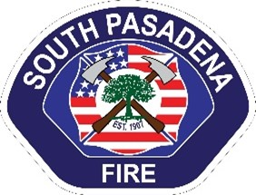
Fire hazard severity zones in local response area
Greg Lloyd, fire chief

Slide 2
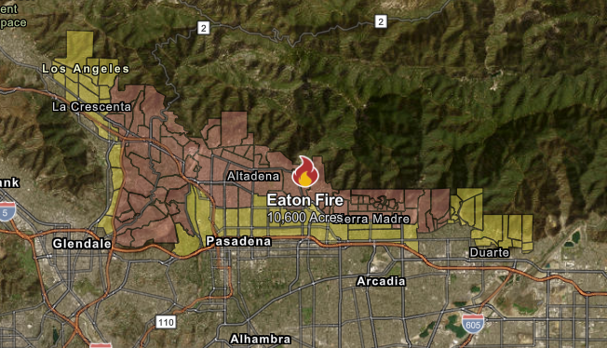
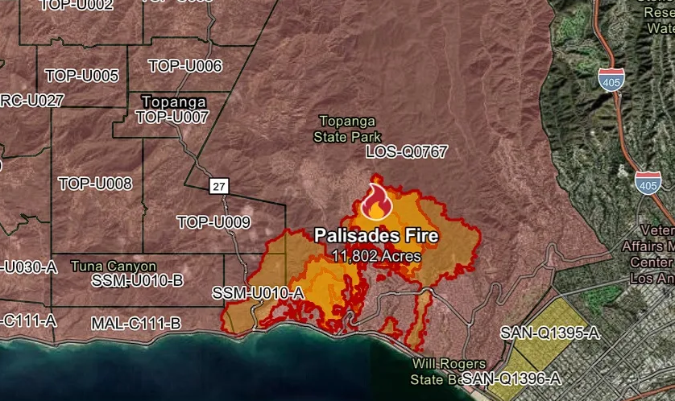
presentation
Introduction
History of Fire Hazard Severity Zones (FHSZ’s)
Applicable Government Codes
FHSZ for South Pasadena
CAL FIRE Methodology and its application
Recommendations
Impact
Insurance
Importance
Notes:
Good evening Mayor, Council and esteemed staff. I am Fire Chief Greg Lloyd and I am here to present regarding the new Fire Hazard Severity Zone Maps released by the California State Fire Marshal’s Office and recommendations for next steps to identify wildfire hazards within the city.
Regardless of cause, empirical evidence has shown an increase in the frequency, severity and damage of wildfires over the past twenty years. In January of 2025, the Eaton Fire, which occurred within five miles of the City of South Pasadena destroyed 14,021 acres, 9,418 homes and took the lives of 17 people (CALFIRE, 2025). As a result of the increase in fires, the Governor ordered the State Fire Marshal’s Office to research and publish Fire Hazard Severity Zone (FHSZ) Maps for Local Responsibility Areas (LRA’s), which would include municipalities such as South Pasadena. Under this mandate, the State Fire Marshal’s Office utilized the same methodology that they employed for determining FHSZ’s in the State Responsibility Areas (SRA’s). However, the state’s staff chose not to include preliminary input from local agencies during the formation process but rather elected to facilitate any proposed changes under Government Code 51179.
The FHSZ maps for the Southern California region were released on March 24, 2025. Although the City of South Pasadena did not originally contain any areas deemed “Very High” FHSZ, the new maps contain areas along the western edge of the city, along the Arroyo Seco and western slope of the Monterey Hills now designated as “Very High”. While these maps were developed using accepted methodology, they lacked the local understanding of terrain and fuel loads and are therefore insufficient in addressing the hazards in Monterey Hills. To clearly identify the wildfire hazards to the City and its residents, Fire Department staff proposes adopting an amended map that combines the methodology of the State Fire Marshal’s Office with the local knowledge of Fire Department Staff.

Slide 3
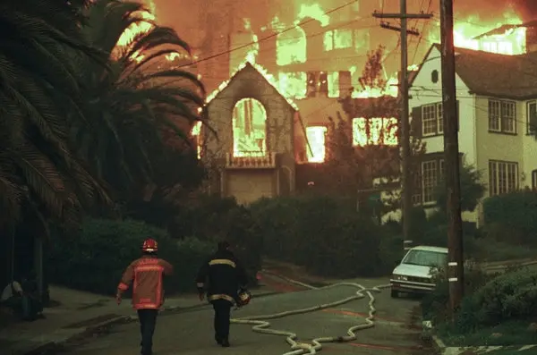
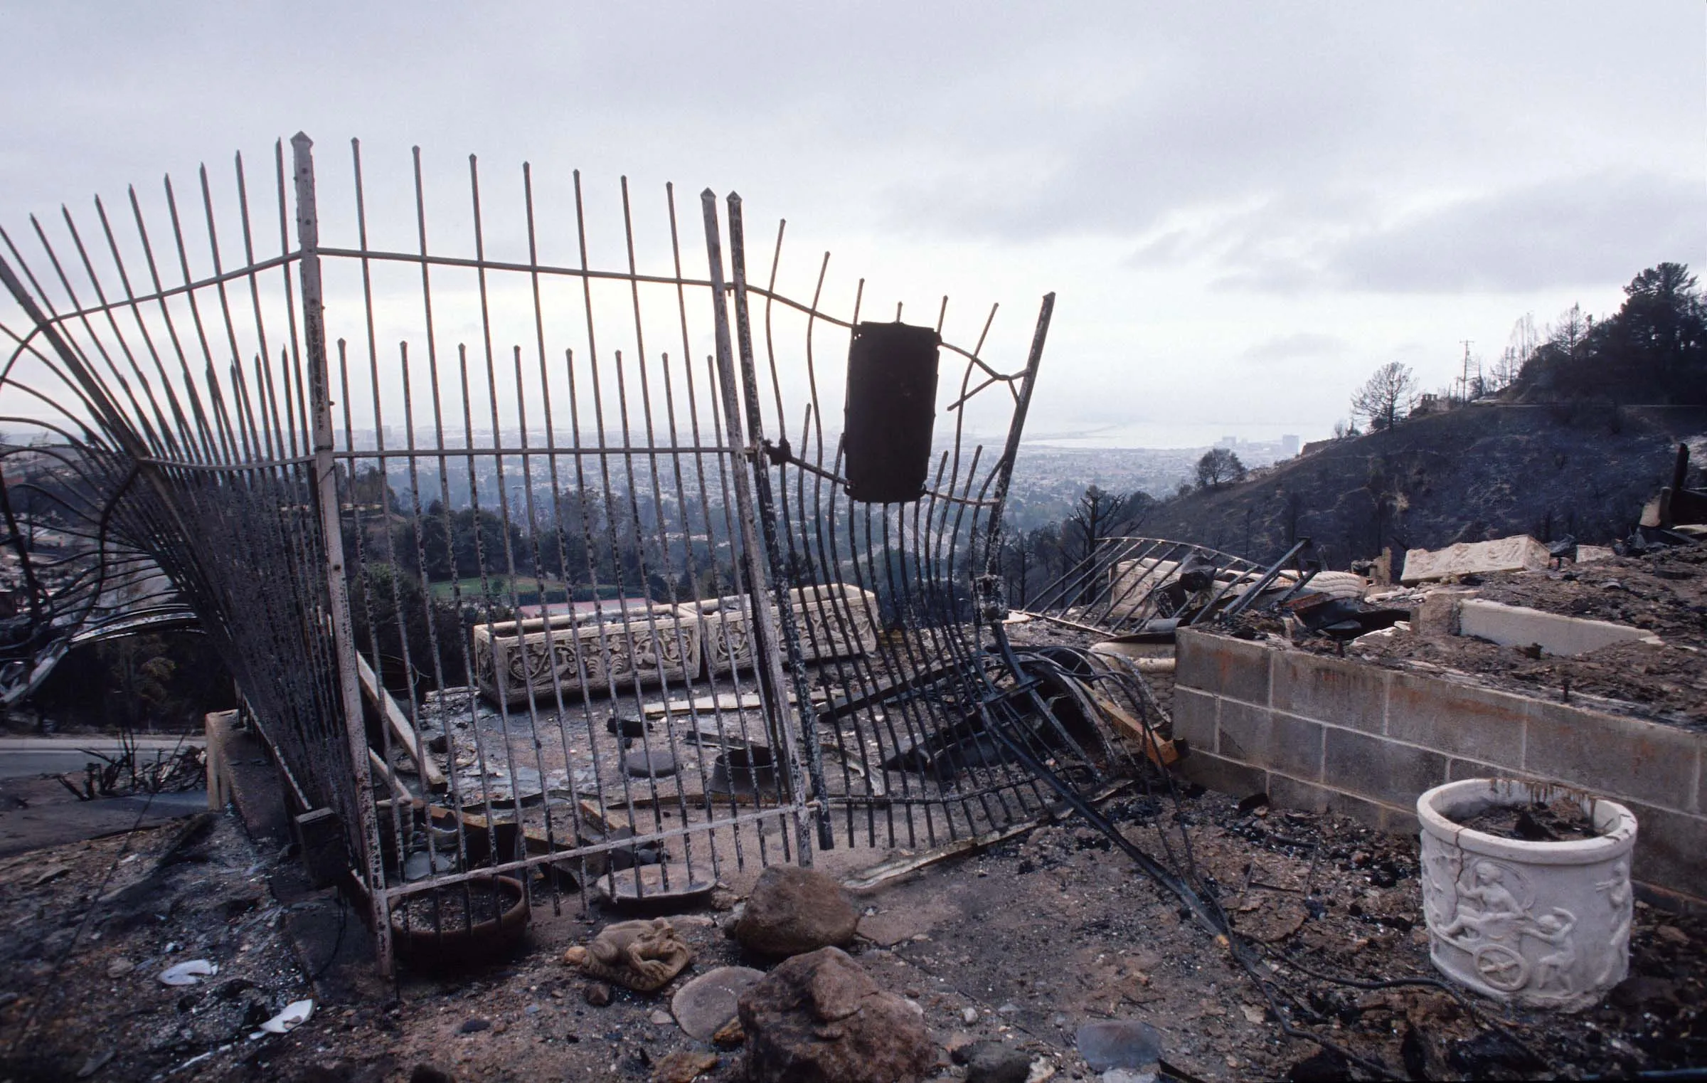
History of fhsz
Resulting from significant fires
  1980 Panorama Fire
  1991 Tunnel Fire (aka Oakland Hills fire)
2021 SB63 requires all three zones to be published
Notes:
FHSZ’s came because of legislation arising out of lessons learned from major wildland fires. In 1980, the Panorama Fire, which began in San Bernardino County and was pushed by strong Santa Ana winds burned 28,800 acres, destroyed 325 structures, and experienced 4 fatalities. In the aftermath, the Governor passed Public Resource Code 4201, which mandated CAL FIRE to develop FHSZ’s in the State Responsibility Areas. Eleven years later, the Tunnel Fire in 1991, which is more widely known as the Oakland Hills Fire, devastated a community that was not previously identified as a hazard zone because it was in a Local Responsibility Area. This fire was significant because it became the deadliest fire to date. Although it only burned 1,520 acres, it destroyed 2,900 structures and was attributed to the death of 25 people.
This event prompted legislators to adopt AB-337 also known as the “Bates Bill”. This bill mandated the Director of CAL FIRE to assess FHSZ’s in Local Responsibility Areas and make recommendations to the local agencies for “Very High” Fire Hazard Severity Zones.
In 2021, new legislation, Senate Bill 63 (Stern), now requires the adoption of all three FHSZ classes in the Local Responsibility Area. Previously, only the “Very High” FHSZ’s were required for adoption in Local Responsibility Areas.
Shortly after I arrived in South Pasadena, I was given a tour of the Monterey Hills. I was surprised at the similarities these hills shared with the Oakland Hills. The steep terrain, dense vegetation and narrow roads shared by both of these areas provide significant challenges for fire response.

Slide 4
Government Codes
Public Resource Code 4202
  The State Fire Marshal shall classify lands within State Responsibility Areas into Fire Hazard Severity Zones. Each zone shall embrace relatively homogeneous lands and shall be based on fuel loading, slope, fire weather, and other relevant factors present, including areas where winds have been identified by the department as a major cause of wildfire spread. Encourage questions and provide thoughtful responses to enhance audience participation Use live polls or surveys to gather audience opinions, promoting engagement and making sure the audience feel involved

Slide 5
Government Codes
Government Code 51178
The State Fire Marshal shall identify areas in the state as Moderate, High, and Very High Fire Hazard Severity Zones based on consistent statewide criteria and based on the severity of fire hazard that is expected to prevail in those areas. Moderate, High, and Very High Fire Hazard Severity Zones shall be based on fuel loading, slope, fire weather, and other relevant factors including areas where winds have been identified by the Office of the State Fire Marshal as a major cause of wildfire spread.

Slide 6
Hazard map not a risk map
Based on the physical conditions that create a likelihood and expected fire behavior over a 30 to 50-year period without considering mitigation measures such as home hardening, recent wildfire, or fuel reduction on efforts
Risk deals with the potential damage a fire can do under existing conditions accounting for mitigation efforts
Notes:
The Fire Hazard Severity Zone map reflects “hazard,” not “risk”. The map is like flood zone maps, where lands are described in terms of the probability level of a particular area being inundated by floodwaters, and not specifically prescriptive impacts. “Hazard” is based on the physical conditions that create a likelihood and expected fire behavior over a 30 to 50-year period without considering mitigation measures such as home hardening, recent wildfire, or fuel reduction efforts. “Risk” is the potential damage a fire can do to the area under existing conditions, accounting for
any modifications such as fuel reduction projects, defensible space, and ignition resistant building construction.
The following is a quote from insurance commissioner Ricardo Lara: For many years, insurance companies have been using wildfire risk models for determining where they will write and renew policies, and how much premium to charge a policyholder -- not the Fire Hazard Severity Zone maps. CAL FIRE’s maps are required by law and their purpose is to drive local planning decisions, not insurance decisions.
Commissioner’s POV: “Let me be clear: The CAL FIRE hazard maps are not used for insurance rates or underwriting decisions. But they will empower communities with more accurate information about the very real hazards we face. The reality is we all need to do more to protect our homes and communities from wildfires. When communities know and understand their risks, they can plan and prepare.”

Slide 7
CAL FIRE METHODOLOGY
Create inputs
Divide land between wildland and non-wildland areas
  Wildland criteria - > 200 acres of contiguous fuel bed
  Non-Wildland – Urban areas, agricultural, barren land and bodies of water.
Formula
Wildland
  Modeling based on topography, weather conditions, drought, and fuel type
Non-Wildland
  Looked at ember cast potential based on wind and proximity to adjoining wildland area
Notes:
The hazard mapping process incorporates local climate data, fuel loading, slope, fire weather and wind to calculate burn potential in certain areas. The state implemented key data inputs to their model and produced results which they repeated throughout the state.
The first step was to divide wildland from non-wildland areas. Wildland areas were deemed as those lands that are predominantly covered by vegetation. Non-wildland area includes urban, agricultural, barren, water or wetlands. To be considered a wildland area, the minimum size of the continuous fuel bed needed to be at least 200 acres.
Once these areas were determined, the models were used to predict fire behavior and spread under extreme fuel and weather conditions. The probability of a fire starting was based on fire history from 1991 to 2020.
On March 25, 2025, Fire Department staff met with members of the CAL FIRE team assigned to this project to review the methodology and express concerns over the modeling. The CAL FIRE team confirmed the methodology based on wildland areas and that non-wildland areas were not necessarily examined by their staff for individual hazards. Rather, non-wildland areas were assessed based on their proximity to wildland areas and the associated ember cast based on historical winds. When asked about the areas within the Monterey Hills and the concerns over the terrain, fuels and density of homes, they deferred to the Fire Department staff’s local knowledge of the hazards and provided information on amending the map under the authority of Government Code 51179.

Slide 8
The power of communication
Current version released 3/24/25
Areas within South Pasadena now designated as Moderate, High and Very High
Notes:
The following map was released on March 24th of this year. In mid-April the map was published as required by code to the fire department website for public access. Public could also access this map through the state’s website.

Slide 9
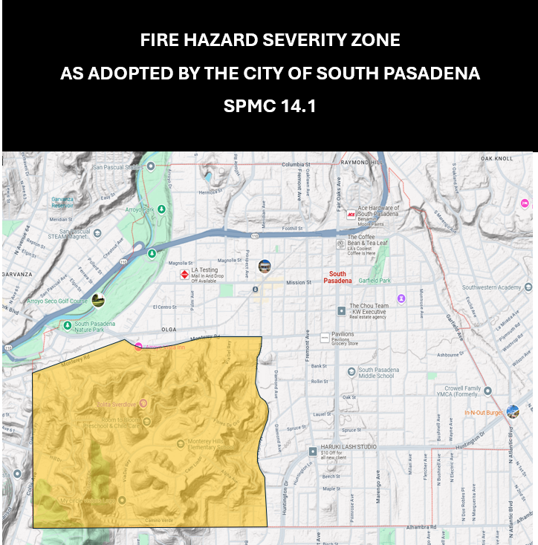
Map as adopted by spmc 14.1
Considered High Fire Hazard Severity Zone for several years
Codified in 2022 as part of the Code Adoption Process
Ord. 2368
Notes:
The following map is based on the verbiage taken from the South Pasadena Municipal Code

Slide 10
Concerns
122 / 660 acres within Monterey Hills not accounted for
Notes:
According to the CAL FIRE methodology, the zones were created based on the ember cast potential from adjacent wildland areas. Based on previous mapping, the Arroyo Seco had been identified as a wildland area as it has greater than 200 acres of contiguous fuels. Using this as the wildland area input and the historically predominant westerly winds, one can follow the logic of the current model. However, there are several smaller areas of contiguous fuel that if ignited provide a significant threat to life and property. For example, the Monterey Hills encompasses 660 acres of land in total but contains 122 acres of vegetation. Of those 122 acres of vegetation, the largest contiguous fuel bed is 50 acres. Of which, 31 acres reside within the City of South Pasadena and the remaining acres reside within the City of Los Angeles. There are 8 areas of contiguous fuel in excess of 4 acres. These areas do not include fuels that may be present in backyards or adjoining property lines. These areas can also contribute to fuel loads and fire behavior.

Slide 11
Requirements
Zone Designation | Requirements
Very High | Legal Adopt FHSZ by ordinance Construction All new construction must use fire-resistive materials listed in Chapter 7A of CBC Defensible Space Clearance AB3074 Defensible Space Clearance Zones 0-30 feet Zero Zone 0-5 feet Annual Defensible Space Inspections Real Estate Disclosure Subdivision Map Disclosure Safety Element Update
Notes:
In January 2020, the State passed AB3074 which would require defensible space zones to be enforced on properties within the Very High FHSZ only for Local Responsibility Areas and includes the High FHSZ in the State Responsibility Areas. The defensible space zones span from 5 to 30 feet from the structure and outline various vegetation requirements. Additionally, an ember-free zone would be required from 0 to 5 feet from the structure. Initially, any combustible materials would not be allowed in this zone, but there is ongoing discussion on this topic and the zero zone requirements may contain exceptions. The law was supposed to go into effect in 2021 but has been delayed. The latest information says that the law will become enforceable in 2026. Any new construction must be compliant at that time, and all existing properties will have until 2029 to come into compliance

Slide 12
Requirements
Zone Designation | Requirements
High | Legal Adopt FHSZ by ordinance Construction All new construction must use fire-resistive materials listed in Chapter 7A of CBC (effective 1/1/2026) Defensible Space Clearance – 100’ (existing) Real Estate Disclosure

Slide 13
AB3074 – Zero Clearance Zone
Signed into law – January 1, 2023
Goes into affect - January 1, 2026
Key Requirements – Only in Very High FHSZ
  Zero Clearance of combustible materials withing 0-5 feet of buildings
  New Construction compliance – January 1, 2026
  Existing property compliance – January 1, 2029
Details are still in development
Notes:
In January 2020, the State passed AB3074 which would require defensible space zones to be enforced on properties within the Very High FHSZ only for Local Responsibility Areas and includes the High FHSZ in the State Responsibility Areas. The defensible space zones span from 5 to 30 feet from the structure and outline various vegetation requirements. Additionally, an ember-free zone would be required from 0 to 5 feet from the structure. Initially, any combustible materials would not be allowed in this zone, but there is ongoing discussion on this topic and the zero zone requirements may contain exceptions. The law was supposed to go into effect in 2021 but has been delayed. The latest information says that the law will become enforceable in 2026. Any new construction must be compliant at that time, and all existing properties will have until 2029 to come into compliance
Overview
Signed into law in 2020; effective January 1, 2026
Amends Public Resources Code Section 4291
Establishes a “Zone 0” (0–5 feet around structures) requirement for defensible space
Key Requirements
Maintain zero clearance of combustible materials within 0–5 feet of buildings
Remove flammable vegetation, mulch, firewood, and other combustibles
Focus on hardening the home ignition zone against embers
Implementation
State law applies in Very High Fire Hazard Severity Zones (VHFHSZ)
CAL FIRE developing regulations and guidelines for defensible space inspections
Compliance may be phased in as local jurisdictions adopt codes
Purpose
Research shows most home ignitions occur from embers within 0–5 feet
Reduces wildfire risk and increases community resilience

Slide 14
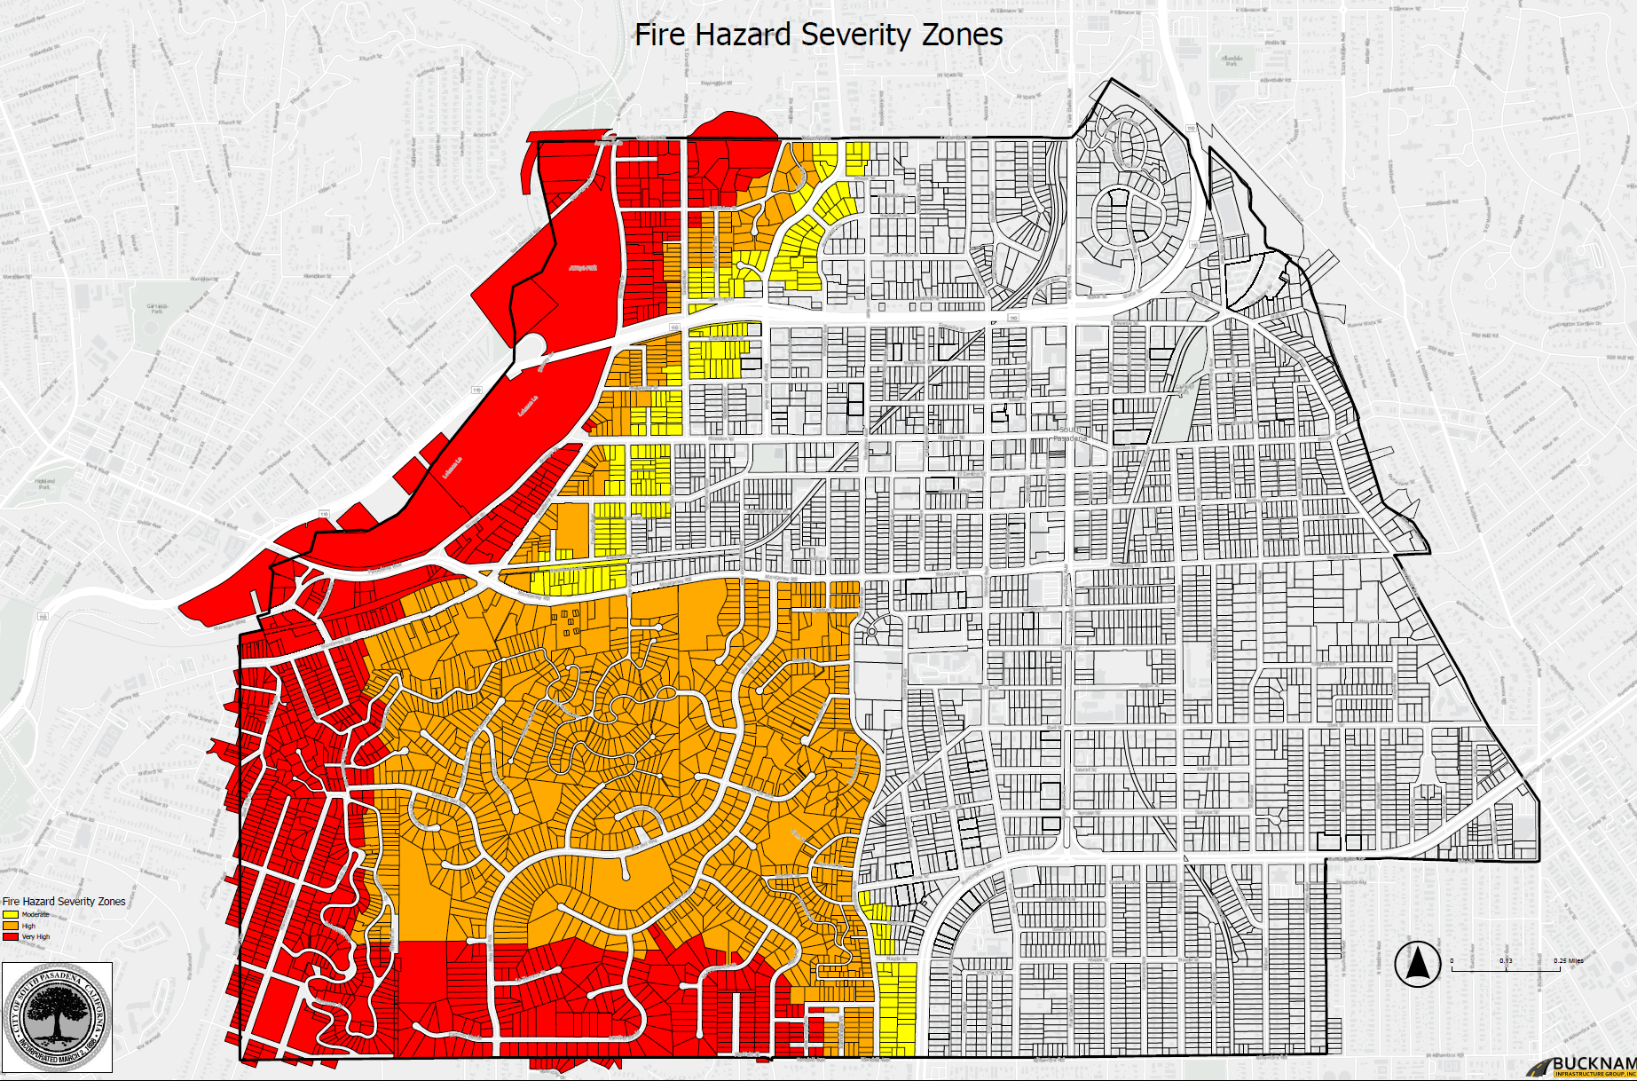
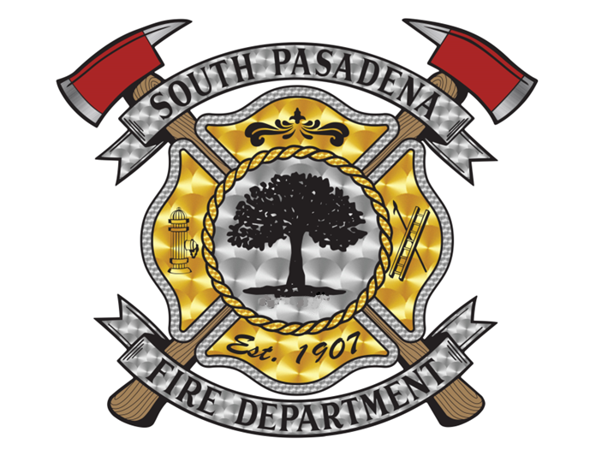
LOCAL AMENDMENTS TO HAZARD MAP
Combined map
Red- Very High FHSZ
Orange – High FHSZ
Yellow – Moderate FHSZ
Notes:
Integrate the State Fire Marshal’s FHSZ Map into the current High Fire Hazard Severity Zone as designated in the SPMC 14.1. Based on the information obtained through state and county resources as well as local knowledge of the topography, vegetation fuel loads and access challenges within the Monterey Hills, it is city’s decision to extend the borders of the High Fire Hazard Severity Zone to encompass the entire Monterey Hills area. The goal of this designation is to educate the residents of the area about the wildfire hazard, provide them information on fire resistant building materials for use in remodeling projects and increase their level of preparedness for a potential wildfire incident in the area

Slide 15
Impact of very high and high fhsz
Building Materials
Defensible Space Inspection requirements
  High – 100’ defensible space
  Very High – 100’ defensible space
    Clearance zones from 5’-30’
    0’-5’ no combustibles (Zero zone)
Real Estate Disclosure
importance
Importance of hardening home against wildfire has a two-fold benefit
  Preserving loss of life and property
  Preventing fire spread to adjacent homes
Notes:
Two main contributors to structures burning in a wildfire
Ember cast from the wildfire itself
Radiant heat from a nearby structure fire
Fire transitions from a wildfire to multiple structures on fire

Slide 16
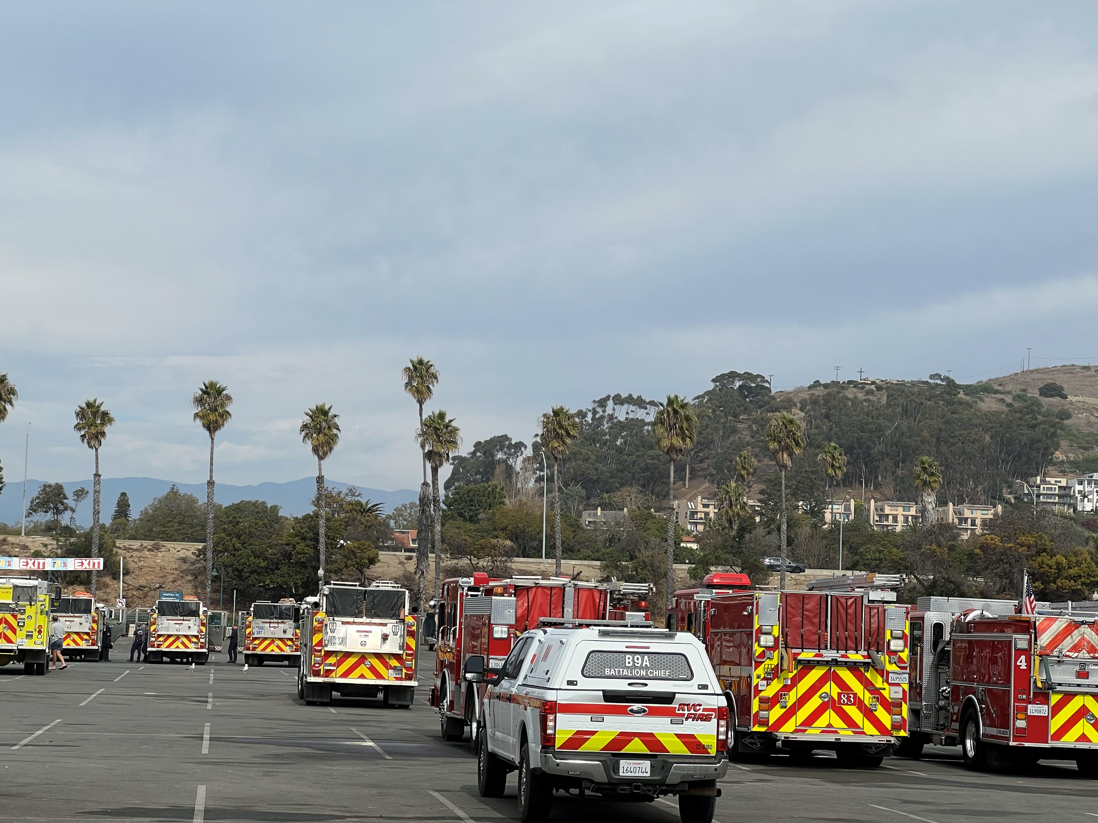
Questions?

